Slide 1
Processor security
CS155

Slide 2
The processor
Part of the trusted computing base (TCB):
but is optimized for performance, … security may be secondary
Processor design and security:
Important security features, such as hardware enclaves, memory encryption (TME), RDRAND, and others.
Some features can be exploited for attacks:
Speculative execution, transactional memory, …
Notes:
TME: total memory encryption. Defends against dual-port memory DIMM, and cold boot attacks.

Slide 3
Intel SGX / TDX
An overview
(Software Guard eXtensions)
Notes:
AMD SME (secure memory encryption) and SEV (secure encrypted virtualization)

Slide 4
SGX: Goals
Extension to Intel processors that support:
Enclaves: running code and memory isolated from the rest of system
Attestation: prove to local/remote system what code is running in enclave
Minimum TCB: only processor is trusted
nothing else: DRAM and peripherals are untrusted
⇒ all writes to memory are encrypted (TME)

Slide 5
Applications
Server side:
Storing a Web server HTTPS secret key:
secret key only opened inside an enclave
⇒ malware cannot get the key
Running a private job in the cloud: job runs in enclave
Cloud admin cannot get code or data of job
Client side:
Hide anti-virus (AV) signatures:
AV signatures are only opened inside an enclave
not exposed to adversary in the clear
Deprecated in INTEL CORE
processors

Slide 6
Intel SGX: how does it work?
An application defines part of itself as an enclave
Untrusted part
Process memory

Slide 7
How does it work?
An application defines part of itself as an enclave
Untrusted part
Enclave
create enclave
isolated memory in process memory space
Process memory

Slide 8
How does it work?
An application defines part of itself as an enclave
Untrusted part
Enclave
enclave code runs
using enclave data
create enclave
call TrustedFun
67g35bd954bt
Process memory
Notes:
Data is stored encrypted in DRAM. Processor prevents access to data in cache outside of enclave.

Slide 9
How does it work?
An application defines part of itself as an enclave
Untrusted part
Enclave
enclave data only
accessible to code
in enclave
create enclave
call TrustedFun
67g35bd954bt
Process memory

Slide 10
How does it work?
Part of process memory holds the enclave:
low
enclave
high
app
code
enclave
code
enclave
data
OS
Process memory
Enclave code and data are written encrypted to main memory
Processor prevents access to cached enclave data outside of enclave.

Slide 11
Creating an enclave: new instructions
Enclave init code loaded as cleartext
ECREATE: establish memory address for enclave
EADD: copies memory pages into enclave
EEXTEND: computes hash of enclave contents (256 bytes at a time)
EINIT: verifies that hashed content is properly signed
if so, initializes enclave (signature = RSA-3072)
EENTER: call a function inside enclave
EEXIT: return from enclave

Slide 12
Provisioning enclave with secrets: attestation
The problem: enclave memory is in the clear prior to activation (EINIT)
How to get secrets into enclave?
Remote Attestation (simplified):
E(pk, data)
report: contains hash(code)
Intel’s app enclave
pk, sk
pk, report
enclave
data
Intel’s quoting enclave
sk
cert = [pk, report]
validate cert

Slide 13
Summary
SGX: an architecture for managing secret data
Intended to process data that cannot be read by anyone, except for code running in enclave
Attestation: proves what code is running in enclave
Minimal TCB: nothing trusted except for x86 processor
Not suitable for legacy applications

Slide 14
An example application
Data science on federated data:
MPC protocol
dataset1
result
dataset2
Can we run analysis on union(dataset1, dataset2) ??
For simple computations, can use multiparty computation (MPC)

Slide 15
An example application
Cert includes hash of enclave code
Data science on federated data:
enclave
pk, cert
pk, cert
analysis code
E(pk, data1)
E(pk, data2)
dataset1
untrusted environment
dataset2
For more complex analysis, can use (secure) hardware enclave

Slide 16
An example application
Cert includes hash of enclave code
Data science on federated data:
enclave
pk, cert
pk, cert
data1
data2
E(pk, data1)
E(pk, data2)
dataset1
dataset2
result
For more complex analysis, can use (secure) hardware enclave

Slide 17
SGX insecurity: (1) side channels
DRAM memory
enclave
memory bus
(enc data)
OS
processor
Attacker controls the OS. OS sees lots of side-channel info:
Memory access patterns
State of processor caches as enclave executes
State of branch predictor
All can leak enclave data.
Difficult to block.

Slide 18
SGX insecurity: (2) extract quoting key
Intel’s quoting enclave
attestation
data
sk
Attestation: proves to 3rd party what code is running in enclave
Quoting sk stored in Intel enclave on untrusted machines
What if attacker extracts sk from some quoting enclave?
Can attest to arbitrary non-enclave code
… see Foreshadow attack and Intel’s response

Slide 19
The Spectre attack
Speed vs. security in HW
[slides credit: Paul Kocher]

Slide 20
Performance drives CPU purchases
Clock speed maxed out:
Pentium 4 reached 3.8 GHz in 2004
Memory latency is slow and not improving much
To gain performance, need to do more per cycle!
Reduce memory delays ⟶ caches
Work during delays ⟶ speculative execution

Slide 21
Memory caches (4-way associative)
Caches hold local (fast) copy of recently-accessed 64-byte chunks of memory
CPU
Sends address, Receives data
MEMORY
CACHE
MAIN MEMORY
Big, slow
e.g. 16GB SDRAM
Set | Addr | Cached Data ~64B
0 | F0016280 31C6F4C0 339DD740 614F8480 | B5 F5 80 21 E3 2C.. 9A DA 59 11 48 F2.. C7 D7 A0 86 67 18.. 17 4C 59 B8 58 A7..
1 | 71685100 132A4880 2A1C0700 C017E9C0 | 27 BD 5D 2E 84 29.. 30 B2 8F 27 05 9C.. 9E C3 DA EE B7 D9.. D1 76 16 54 51 5B..
2 | 311956C0 002D47C0 91507E80 55194040 | 0A 55 47 82 86 4E.. C4 15 4D 78 B5 C4.. 60 D0 2C DD 78 14.. DF 66 E9 D0 11 43..
3 | 9B27F8C0 8E771100 A001FB40 317178C0 | 84 A0 7F C7 4E BC.. 3B 0B 20 0C DB 58.. 29 D9 F5 6A 72 50.. 35 82 CB 91 78 8B..
4 | 6618E980 BA0CDB40 89E92C00 090F9C40 | 35 11 4A E0 2E F1.. B0 FC 5A 20 D0 7F.. 1C 50 A4 F8 EB 6F.. BB 71 ED 16 07 1F..
Address:
132E1340
Addr: 2A1C0700
Data:
AC 99 17 8F 44 09..
hash(addr) to map to cache set
Fast
2A1C0700
Data: 9E C3 DA EE B7 D3..
Addr: 132E1340
Reads change system state:
Read to newly-cached location is fast
Read to evicted location is slow
Data: AC 99 17 8F 44 09..
Slow
Fast
Addr: 132E1340
Evict to make room
132E1340
AC 99 17 8F 44 09..
Data: AC 99 17 8F 44 09..

Slide 22
Speculative execution
CPUs can guess likely program path and do speculative execution
Example:
if (uncached_value == 1) // load from memory
a = compute(b)
Branch predictor guesses if() is ‘true’ (based on prior history)
Starts executing compute(b) speculatively
When value arrives from memory, check if guess was correct:
Correct: Save speculative work ⇒ performance gain
Incorrect: Discard speculative work ⇒ no harm
????
Notes:
Prior history: branch predictor.

Slide 23
Architectural Guarantee
Register values eventually match result of in-order execution
Speculative Execution
CPU regularly performs incorrect calculations, then deletes mistakes
Is making + discarding mistakes the same as in-order execution?
The processor executed instructions that were not supposed to run !!
The problem: instructions can have observable side-effects

Slide 24
Conditional branch (Variant 1) attack
if (x < array1_size)
y = array2[ array1[x]*4096 ];
Suppose unsigned int x comes from untrusted caller
Execution without speculation is safe:
array2[array1[x]*4096] not eval unless x < array1_size
What about with speculative execution?

Slide 25
Conditional branch (Variant 1) attack
Memory & Cache Status
array1_size = 00000008
Memory at array1 base:
8 bytes of data (value doesn’t matter) Memory at array1 base+1000:
09 F1 98 CC 90...(something secret)
array2[ 0*4096]
array2[ 1*4096]
array2[ 2*4096]
array2[ 3*4096]
array2[ 4*4096]
array2[ 5*4096]
array2[ 6*4096]
array2[ 7*4096]
array2[ 8*4096]
array2[ 9*4096]
array2[10*4096]
array2[11*4096]
if (x < array1_size)
y = array2[array1[x]*4096];
Before attack:
Train branch predictor to expect if() is true (e.g. call with x < array1_size)
Evict array1_size and array2[] from cache
Contents don’t matter
only care about cache status
Uncached
Cached
• • •

Slide 26
Conditional branch (Variant 1) attack
Memory & Cache Status
array1_size = 00000008
Memory at array1 base:
8 bytes of data (value doesn’t matter) Memory at array1 base+1000:
09 F1 98 CC 90...(something secret)
array2[ 0*4096]
array2[ 1*4096]
array2[ 2*4096]
array2[ 3*4096]
array2[ 4*4096]
array2[ 5*4096]
array2[ 6*4096]
array2[ 7*4096]
array2[ 8*4096]
array2[ 9*4096]
array2[10*4096]
array2[11*4096]
if (x < array1_size)
y = array2[array1[x]*4096];
Attacker calls victim with x=1000
Speculative exec while waiting for array1_size:
Predict that if() is true
Read address (array1 base + x) (using out-of-bounds x=1000)
Read returns secret byte = 09 (in cache ⇒ fast )
Contents don’t matter
only care about cache status
Uncached
Cached
• • •

Slide 27
Conditional branch (Variant 1) attack
Memory & Cache Status
array1_size = 00000008
Memory at array1 base:
8 bytes of data (value doesn’t matter) Memory at array1 base+1000:
09 F1 98 CC 90...(something secret)
array2[ 0*4096]
array2[ 1*4096]
array2[ 2*4096]
array2[ 3*4096]
array2[ 4*4096]
array2[ 5*4096]
array2[ 6*4096]
array2[ 7*4096]
array2[ 8*4096]
array2[ 9*4096]
array2[10*4096]
array2[11*4096]
if (x < array1_size)
y = array2[array1[x]*4096];
Attacker calls victim with x=1000
Next:
Request mem at (array2 base + 09*4096)
Brings array2[09*4096] into the cache
Realize if() is false: discard speculative work
proceed to next instruction
Contents don’t matter
only care about cache status
Uncached
Cached
• • •

Slide 28
Conditional branch (Variant 1) attack
Memory & Cache Status
array1_size = 00000008
Memory at array1 base:
8 bytes of data (value doesn’t matter) Memory at array1 base+1000:
09 F1 98 CC 90...(something secret)
array2[ 0*4096]
array2[ 1*4096]
array2[ 2*4096]
array2[ 3*4096]
array2[ 4*4096]
array2[ 5*4096]
array2[ 6*4096]
array2[ 7*4096]
array2[ 8*4096]
array2[ 9*4096]
array2[10*4096]
array2[11*4096]
if (x < array1_size)
y = array2[array1[x]*4096];
Attacker calls victim with x=1000
Attacker: (another process or core)
for i=0 to 255: measure read time for array2[i*4096]
When i=09 read is fast (cached), reveals secret byte !!
Repeat with many x (10KB/s)
Contents don’t matter
only care about cache status
Uncached
Cached
• • •

Slide 29
Violating JavaScript’s sandbox
Browsers run JavaScript from untrusted websites
JIT compiler inserts safety checks, including bounds checks on array accesses
Speculative execution runs through safety checks…
JIT thinks this check ensures index < length, so it omits bounds check in next line. Separate code evicts length for attack passes
index will be in-bounds on training passes, and out-of-bounds on attack passes
Do the out-of-bounds read on attack passes!
if (index < simpleByteArray.length) {
index = simpleByteArray[index | 0];
index = (((index * TABLE1_STRIDE)|0) & (TABLE1_BYTES-1))|0;
localJunk ^= probeTable[index|0]|0;
}
“|0” is a JS optimizer trick (makes result an integer)
4096 bytes = memory page size
Need to use the result so the operations aren’t optimized away
Keeps the JIT from adding unwanted bounds checks on the next line
Leak out-of-bounds read result into cache state!
Can evict length/probeTable from JavaScript (easy)
… then use timing to detect newly-cached location in probeTable

Slide 30
Variant 2: indirect branches
Indirect branches: can go anywhere , e.g. jmp[rax]
If destination is delayed, CPU guesses and proceeds speculatively
Find an indirect jmp with attacker controlled register(s) … then cause mispredict to a useful ‘gadget’ y = array2[array1[x]*4096];
Attack steps:
Mistrain branch prediction so speculative execution will go to gadget
Evict address [rax] from cache to cause speculative execution
Execute victim so it runs gadget speculatively
Detect change in cache state to determine memory data

Slide 31
Non-mitigations
Can we prevent Spectre without a huge cost in performance?
Idea 1: fully restore cache state when speculation fails.
Problem: Insecure!
Speculative execution can have observable side effects beyond the cache state
if (x < array1_size) {
y = array1[x];
do_something_observable(y);
}
occupy a bus: detectable from another core,
or cause EM radiation

Slide 32
Variant 1 mitigation: Speculation stopping instruction (e.g. LFENCE)
Idea: insert LFENCE on all vuln. code paths
if (x < array1_size)
LFENCE // processor instruction
y = array2[ array1[x]*4096 ];

Slide 33
Variant 1 mitigation: Speculation stopping instruction (e.g. LFENCE)
Claim: efficient, no performance impact on benchmark software
Often millions of control flow paths
Too confusing - speculation runs 188++ instructions, crosses modules
Too risky – miss one and attacker can read entire process memory
Insert LFENCEs manually?
Put LFENCES everywhere?
Abysmal performance - LFENCE is very slow
✓
Must protect against all potentially-exploitable patterns
Supported in LLVM, along with other mitigations
⟹ protects all LLVM-based compilers
Insert by smart compiler?
Transfer of blame (CPU -> SW): “you should have put an LFENCE there”
Notes:
LLVM hardening: https://llvm.org/docs/SpeculativeLoadHardening.html

Slide 34
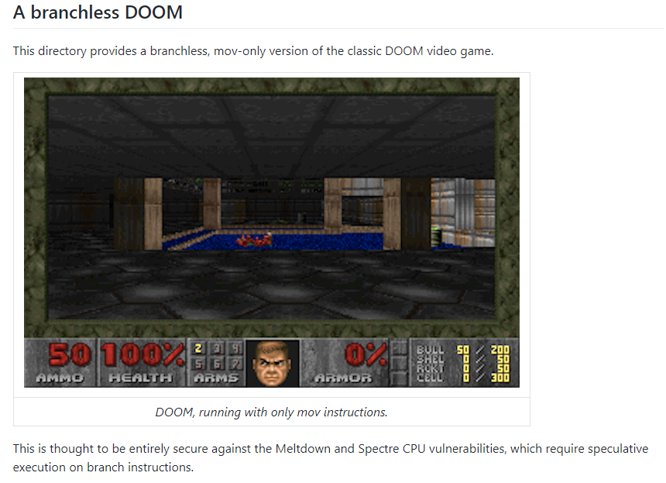
Mitigations: Indirect branch variant
Remove all branches?
DOOM with no branches:
One frame every ~7 hours
Oops! Variant 4: speculative store

Slide 35
Mitigations: summary
Mitigations are messy for all Spectre variants:
Software must deal with microarchitectural complexity
Mitigations for all variants are really hard to test:
active area of research
More ideas needed !

Slide 36
... but there is more
More speculative execution attacks:
Meltdown
Rogue inflight data load (RIDL) and Fallout
ZombieLoad
Store-to-leak forwarding
Micro-op caches (June 2020)
Enable reading unauthorized memory (client, cloud, SGX)
Mitigating incurs significant performance costs

Slide 37
How to evaluate a processor?
Processors are measured by their performance on benchmarks:
Processor vendors add many architectural features to speed-up benchmarks
Until recently: security implications were secondary
⇒ lots of security issues found in last four years
… likely more will be found in coming years

Slide 38
THE END

