Slide 1

Symmetric encryption, Public key encryption, and TLS
Crypto Concepts

Slide 2
Cryptography
Is:
  A tremendous tool for protecting information
  The basis for many security mechanisms
Is not:
  The solution to all security problems
  Reliable unless implemented and used properly
  Something you should try to invent yourself

Slide 3
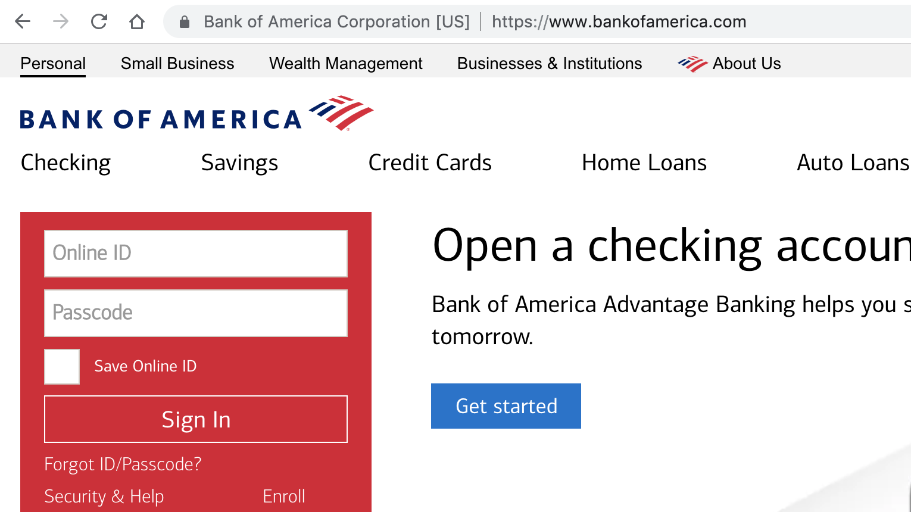
Goal 1: Secure communication
(protecting data in motion)
no eavesdropping
no tampering

Slide 4
Transport Layer Security / TLS
Standard for Internet security
  Goal: “... provide privacy and reliability between two communicating applications”
Two main parts
  1. Handshake Protocol: Establish shared secret key
  using public-key cryptography
  2. Record Layer: Transmit data using negotiated key
Our starting point: Using a key for encryption and integrity

Slide 5
Goal 2: protected files
(protecting data at rest)
File system
File 1
Alice
Alice
No eavesdropping
No tampering
File 2

Slide 6
Building block: symmetric cipher
nonce
E, D: cipher k: secret key (e.g. 128 bits)
m, c: plaintext, ciphertext n: nonce (non-repeating)
Encryption algorithm is publicly known
  ⇒ never use a proprietary cipher
Alice
Bob
m, n
E
E(k,m,n)=c
c, n
D
D(k,c,n)=m
k
k

Slide 7
Use Cases
Single use key: (one time key)
  Key is only used to encrypt one message
    encrypted email: new key generated for every email
  No need for nonce (set to 0)
Multi use key: (many time key)
  Key is used to encrypt multiple messages or multiple files
    TLS: same key used to encrypt many frames
  Use either a unique nonce or a random nonce

Slide 8
First example: One Time Pad (single use key)
Vernam (1917)
Key:
0
1
0
1
1
1
0
0
1
0
⊕
Plaintext:
1
1
0
0
0
1
1
0
0
0
Ciphertext:
1
0
0
1
1
0
1
0
1
0
Encryption: c = E(k, m) = m ⨁ k
Decryption: D(k, c) = c ⨁ k
= (m ⨁ k) ⨁k = m
Notes:
Fill in CT manually.

Slide 9
One Time Pad (OTP) Security
Shannon (1949):
  OTP is “secure” against one-time eavesdropping
  without key, ciphertext reveals no “information”
  about plaintext
Problem: OTP key is as long as the message

Slide 10
Stream ciphers (single use key)
Problem: OTP key is as long as the message
Solution: Pseudo random key -- stream ciphers
Example: ChaCha20 (one-time if no nonce) key: 128 or 256 bits.
key
c ← PRG(k) ⊕ m
PRG
⊕
message
ciphertext
Notes:
Pentium 4, 2.1GhZ

Slide 11
Dangers in using stream ciphers
One time key !! “Two time pad” is insecure:
c₁ ← m₁ ⊕ PRG(k)
  c₂ ← m₂ ⊕ PRG(k)
  Eavesdropper does:
  c₁ ⊕ c₂ → m₁ ⊕ m₂
  Enough redundant information in English that:
  m₁ ⊕ m₂ → m₁ , m₂
What if want to use
same key to encrypt
two files?

Slide 12
Block ciphers: crypto work horse
n bits
n bits
E, D
PT Block
CT Block
Key
k Bits
Canonical examples:
3DES (old): n= 64 bits, k = 168 bits
AES: n=128 bits, k = 128, 192, 256 bits

Slide 13
Block Ciphers Built by Iteration
key k
key expansion
k₁
k₂
k₃
k_{n}
m
R(k₁, ⋅)
R(k₂, ⋅)
R(k₃, ⋅)
R(k_{n}, ⋅)
c
R(k,m): round function
for AES128: 10 rounds, AES256: n=14 rounds

Slide 14
Example: AES128
input: 128-bit block m, 128-bit key k. output: 128-bit block c.
Difficult to design: must resist subtle attacks
• differential attacks, linear attacks, brute-force, …
key k
key expansion
k₀
k₁
k₂
k₁₀
m
⊕
π
⊕
π
⊕
π
⊕
c
’

Slide 15
AES-NI: AES in hardware (Intel, AMD, ARM)
New x86 hardware instructions used to implement AES:
aesenc, aesenclast: one round of AES
aesenc xmm1, xmm2 (result written to xmm1)
aesdec, aesdeclast: one round of AES
aeskeygenassist: do AES key expansion
⟹ more than 10x speedup over a software AES
⟹ better security: all AES instructions are constant time
state
round key
Notes:
When AES-NI not available (e.g., cheap Android phones) use ChaCha20

Slide 16
Incorrect use of block ciphers
Electronic Code Book (ECB):
Problem:
  if m₁=m₂ then c₁=c₂
PT:
m₁
m₂
CT:
c₁
c₂

Slide 17
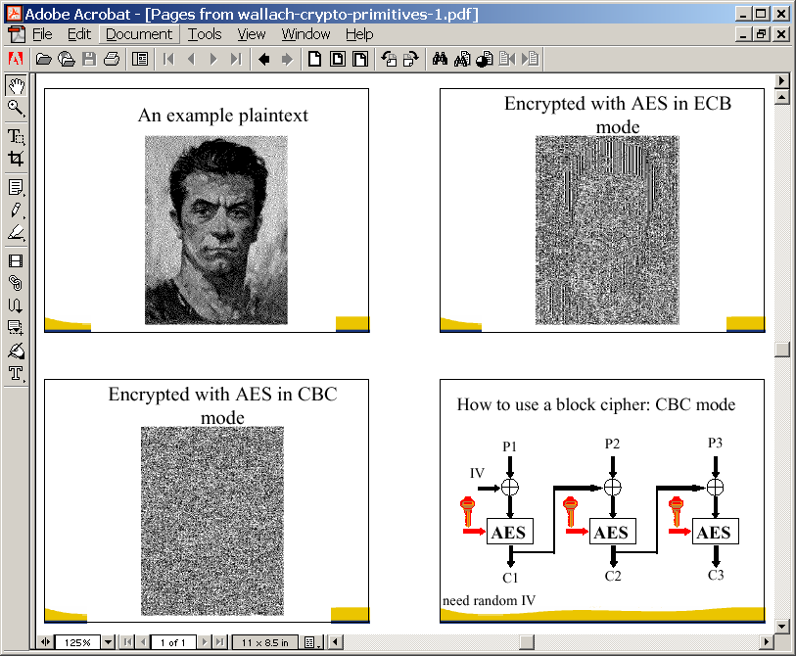
In pictures

Slide 18
CTR mode encryption (eavesdropping security)
Counter mode with a random IV: (parallel encryption)
IV
m[0]
m[1]
…
m[L]
⊕
E(k,IV)
E(k,IV+1)
…
E(k,IV+L)
IV
c[0]
c[1]
…
c[L]
ciphertext
Why is this secure for multiple messages? See the crypto course (cs255)

Slide 19
A Warning
eavesdropping security is insufficient for most applications
Need also to defend against active (tampering) attacks.
CTR mode is insecure against active attacks!
Next: methods to ensure message integrity

Slide 20
Message Integrity: MACs
Goal: provide message integrity. No confidentiality.
  ex: Protecting public binaries on disk.
k
k
message m
tag
Alice
Bob
Generate tag:
tag ← S(k, m)
Verify tag:
V(k, m, tag) = `yes’
?

Slide 21
Construction: HMAC (Hash-MAC)
Most widely used MAC on the Internet.
H: hash function.
example: SHA-256 ; output is 256 bits
Building a MAC out of a hash function:
  Standardized method: HMAC
  S( k, msg ) = H( k⊕opad ‖ H( k⊕ipad ‖ msg ) )

Slide 22
SHA-256: Merkle-Damgard
m[0]
m[1]
m[2]
m[3]
IV
(fixed)
h
h
h
h
H(m)
h(t, m[i]): compression function
Thm 1: if h is collision resistant then so is H
“Thm 2”: if h is a “PRF” then HMAC is a secure MAC

Slide 23
Why is this MAC construction secure?
… see the crypto course (cs255)

Slide 24
Combining MAC and ENC (Auth. Enc.)
Encryption key k_{E}. MAC key = k_{I}
Option 1: (SSL)
Option 2: (IPsec, TLS 1.3)
Option 3: (SSH)
MAC(k_{I}, m)
enc k_{E}
msg m
msg m
MAC
Enc k_{E}
MAC(k_{I}, c)
always
correct
msg m
MAC
enc k_{E}
MAC(k_{I}, m)
msg m
MAC

Slide 25
AEAD: Auth. Enc. with Assoc. Data
AEAD:
encrypted
associated data
encrypted data
authenticated
AES-GCM: CTR mode encryption then MAC
(MAC accelerated via Intel’s PCLMULQDQ instruction)

Slide 26
Example AES-GCM functions
int encrypt(
unsigned char *key, // key
unsigned char *iv, int iv_len, // nonce
unsigned char *plaintext, int plaintext_len, // plaintext
unsigned char *aad, int aad_len, // assoc. data
unsigned char *ciphertext ) // output ct
int decrypt( // error if invalid MAC on (aad, ciphertext)
unsigned char *key, // key
unsigned char *ciphertext, int ciphertext_len, // plaintext
unsigned char *aad, int aad_len, // assoc. data
unsigned char *plainrtext ) // output pt

Slide 27
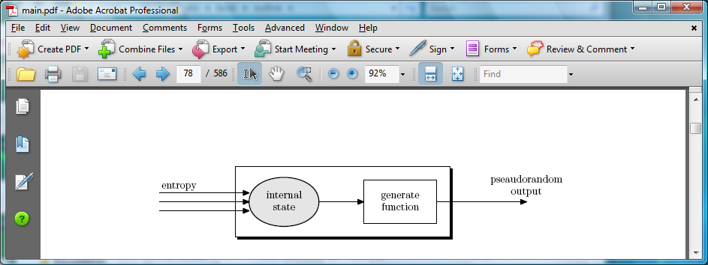
Generating Randomness (e.g. keys, nonces)
Pseudo random generators in practice: (e.g. /dev/random)
  Continuously add entropy to internal state
  Entropy sources:
    Hardware RNG: Intel RdRand inst. (Ivy Bridge). 3Gb/sec.
  Timing: hardware interrupts (keyboard, mouse)

Slide 28
Summary
Shared secret key:
Used for secure communication and document encryption
Encryption: (eavesdropping security) [should not be used standalone]
One-time key: ex: a stream cipher
Many-time key: ex: AES-CTR with a unique/random nonce
Integrity: HMAC
Authenticated encryption: encrypt-then-MAC using AES-GCM

Slide 29
encryption and compression problems
Crypto Concepts

Slide 30
Encryption and compression: oil and vinegar
HTTP: uses compression to reduce bandwidth
Option 1: first encrypt and then compress
Does not work … ciphertext looks like a random string
Option 2: first compress and then encrypt
Used in many Internet protocols (TLS, HTTP, QUIC, …)
Trouble …

Slide 31
Trouble … [Kelsey’02]
Compress-then-encrypt reveals information:
POST /bank.com/buy?id=aapl
Cookie: uid=jhPL8g69684rksfsdg
POST /bank.com/buy?id=goog
Cookie: uid=jhPL8g69684rksfsdg
Second message compresses better than first:
network observer can distinguish the two messages!

Slide 32
Even worse: the CRIME attack [RD’2012]
(simplified)
Goal: steal user’s bank cookie
POST /bank.com/buy?id=aapl
Cookie: uid=jhPL8g69684rksfsdg
Javascript
Javascript can issue requests to Bank,
but cannot read Cookie value

Slide 33
Even worse: the CRIME attack [RD’2012]
Goal: steal user’s bank cookie
POST /bank.com/buy?id=uid=a
Cookie: uid=jhPL8g69684rksfsdg
Javascript
observe ciphertext size

Slide 34
Even worse: the CRIME attack [RD’2012]
Goal: steal user’s bank cookie
POST /bank.com/buy?id=uid=b
Cookie: uid=jhPL8g69684rksfsdg
Javascript
observe ciphertext size

Slide 35
Even worse: the CRIME attack [RD’2012]
Goal: steal user’s bank cookie
POST /bank.com/buy?id=uid=j
Cookie: uid=jhPL8g69684rksfsdg
Javascript
ciphertext slightly shorter
⇒ first character of Cookie is “j”

Slide 36
Even worse: the CRIME attack [RD’2012]
Goal: steal user’s bank cookie
POST /bank.com/buy?id=uid=ja
Cookie: uid=jhPL8g69684rksfsdg
Javascript
observe ciphertext size

Slide 37
Even worse: the CRIME attack [RD’2012]
Goal: steal user’s bank cookie
POST /bank.com/buy?id=uid=jh
Cookie: uid=jhPL8g69684rksfsdg
Javascript
ciphertext slightly shorter
⇒ 2nd character of Cookie is “h”

Slide 38
Even worse: the CRIME attack [RD’2012]
Goal: steal user’s bank cookie
POST /bank.com/buy?id=uid=jh
Cookie: uid=jhPL8g69684rksfsdg
Javascript
Recover entire cookie after
256 × |Cookie| tries
Takes several minutes (simplified)

Slide 39
What to do?
Disable compression ☹️
Use a different compression context for parts
under Javascript control and parts that are not
Change secret (Cookie) after every request
Does not eliminate inherent leakage due to compression

Slide 40
Public key cryptography
Crypto Concepts

Slide 41
(1) Public-key encryption
Tool for managing or generating symmetric keys
E – Encryption alg. PK – Public encryption key
D – Decryption alg. SK – Private decryption key
Algorithms E, D are publicly known.
Alice₁
m₁
Bob
E
E(PK, m₁)=c₁
c
D
D(SK,c)=m
Alice₂
m₂
E
E(PK, m₂)=c₂

Slide 42
Building block: trapdoor permutations
1. Algorithm KeyGen: outputs pk and sk
2. Algorithm F(pk, ⋅) : a one-way function
  Computing y = F(pk, x) is easy
  One-way: given random y, finding x s.t. y = F(pk,x) is difficult
3. Algorithm F⁻¹(sk, ⋅) : Invert F(pk, ⋅) using trapdoor SK
  F⁻¹(sk, y ) = x
Notes:
Example: cube and cube root.

Slide 43
Example: RSA
1. KeyGen: generate two equal length primes p, q
set N ← p⋅q (3072 bits ≈ 925 digits)
set e ← 2¹⁶+1 = 65537 ; d ← e⁻¹ (mod ϕ(N))
pk = (N, e) ; sk = (N, d)
2. RSA(pk, x) : x → (x^{e} mod N)
  Inverting this function is believed to be as hard as factoring N
3. RSA⁻¹(pk, y) : y → (y^{d} mod N)
Notes:
RSA: skip slide

Slide 44
Public Key Encryption with a TDF
c₀
c₁
KeyGen: generate pk and sk
Encrypt(pk, m):
  choose random x ∈ domain(F) and set k ← H(x)
  c₀ ← F(pk, x) , c₁ ← E(k, m) (E: symmetric cipher)
  send c = (c₀, c₁)
Decrypt(sk, c=(c₀,c₁) ): x ← F⁻¹(sk, c₀) , k ← H(x) , m ← D(k, c₁)
security analysis in crypto course (cs255)

Slide 45
(2) Digital signatures
Goal: bind document to author
  Problem: attacker can copy Alice’s sig from one doc to another
Main idea: make signature depend on document
Example: signatures from a trapdoor permutation (e.g. RSA)
    sign( sk, m) := F⁻¹ (sk, H(m) )
    verify(pk, m, sig) := accept if F(pk, sig) = H(m)

Slide 46
Digital signatures
Goal: bind document to author
  Problem: attacker can copy Alice’s sig from one doc to another
Main idea: make signature depend on document
Example: signatures from a trapdoor permutation (e.g. RSA)
    sign( sk, m) := F⁻¹ (sk, H(m) )
    verify(pk, m, sig) := accept if F(pk, sig) = H(m)
Only someone who knows sk can sign a message m
Anyone who has pk can verify a (msg, signature) pair

Slide 47
Digital Sigs. from a Trapdoor Permutation
sign(sk, msg):
verify(pk, msg, sig):
msg
msg
H
H
≟ ⇒
accept
or
reject
F⁻¹(sk,⋅)
sig
F(pk,⋅)
sig

Slide 48

  Certificates: bind Bob’s ID to a PK
How does Alice (browser) obtain Bob’s public key pk_{Bob} ?
Browser
Alice
Server Bob
CA
generate
(sk,pk)
pk and
proof “I am Bob”
check
proof
sk_{CA}
pk_{CA}
pk_{CA}
issue Cert with sk_{CA} :
Bob’s
key is pk
verify
cert
Bob’s
key is pk
Bob uses Cert for an extended period (e.g. one year)

Slide 49
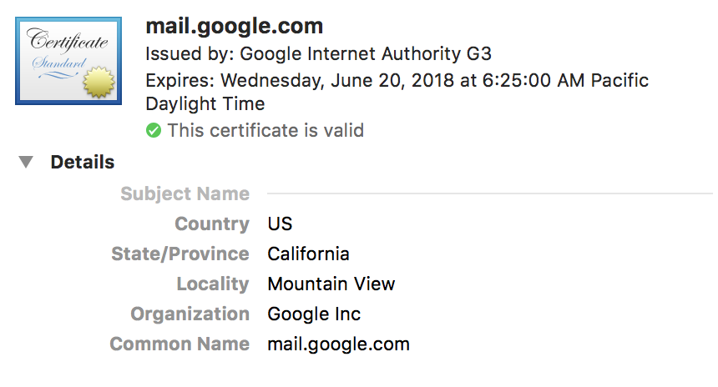
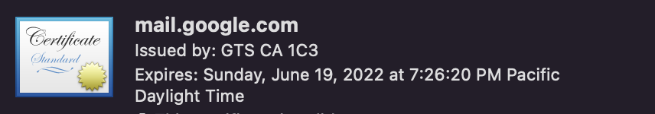
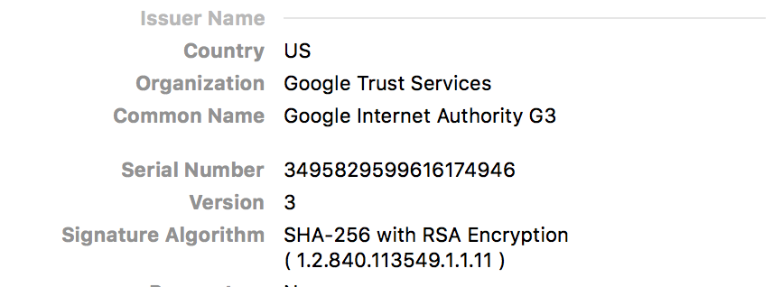
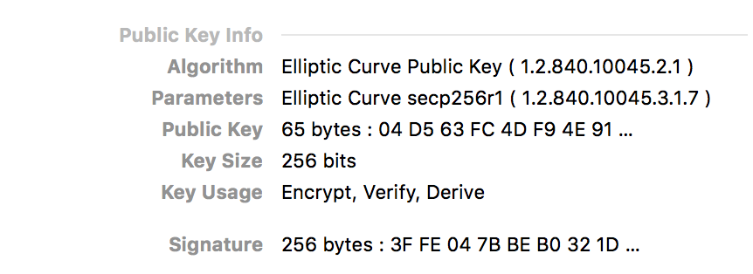
Sample certificate:

Slide 50
Signature schemes used in the real world
RSA signature scheme:
Fast to verify, but signatures are long
Often used in certificates
ECDSA, Schnorr, BLS signature schemes:
Faster to generate signature and more compact than RSA
Used everywhere, other than web certificates

Slide 51
(3) Key exchange
Goal: Browser and Server want a shared secret, unknown to attacker
Browser
Server
attacker ??
key
key
Example: Diffie-Hellman key exchange.
Only secure against eavesdropping
TLS 1.3: enhances Diffie-Hellman key exchange
⟹ security against an active attacker

Slide 52
Back to TLS 1.3 session setup (simplified)
Client
ClientHello
Server
C
S
ServerHello,
[Certificate],
[CertificateVerify],
[Finished]
secret
key
[Certificate],
[CertificateVerify]
Finished
AppilcationData
cert_{S}
ApplicationData

Slide 53
TLS 1.3 session setup (simplified)
Diffie-Hellman key exchange
Client
ClientHello: nonce_{C} , KeyShare
Server
ServerHello: nonce_{S} , KeyShare, Enc[cert_{S},…]
CertVerify: Enc[Sig_{S}(data)] , Finished
secret
key
cert_{S}
Finished
session-keys ← HKDF( DHkey, nonce_{C} , nonce_{S} )
Encrypted ApplicationData
Encrypted ApplicationData

Slide 54
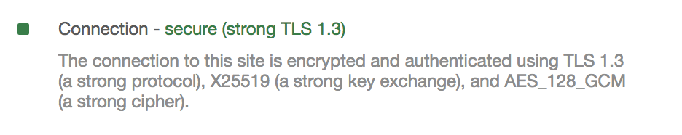
Properties
Gmail
Nonces: prevent replay of an old session
Forward secrecy: server compromise does not expose old sessions
Some identity protection: certificates are sent encrypted
One sided authentication:
  Browser identifies server using server-cert
  TLS has support for mutual authentication
    requires a client pk/sk and client-cert

Slide 55
A brief sample of advanced crypto
Crypto Concepts

Slide 56

Protocols
v₁
v₂
v₃
v₄
Elections
Can we do the same without
a trusted party?
trusted
authority
MAJ(v₁, v₂, v₃, v₄)

Slide 57
Protocols
v₁
v₂
v₃
v₄
Elections
Private auctions
Secure multi-party computation
f(v₁, v₂, v₃, v₄)
Goal: compute f(v₁, v₂, v₃, v₄)
“Thm:” anything that can be done with a trusted authority
can also be done without

Slide 58
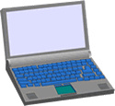

Magical applications
Privately outsourcing computation
Zero knowledge (proof of knowledge)
What did she search for?
search
query
E[ query ]
Alice
E[ results ]
results
Google
???
N=p∙q
Alice
I know the factors of N !!
proof π
N
Bob
Notes:
ZKPK: can be used for authentication

Slide 59
Privacy: Group Signatures
msg
User 1
sig
Key Issuer
Is sig from user 1 or 2?
User 2
Simple solution: give all users same private key
… but also need to revoke signers when they misbehave

Slide 60
Example: Vehicle Safety Comm. (VSC)
1.
Car 1
Car 2
Car 3
Car 4
brake
out of my way !!
2.
Car
Ambulance
Require authenticated (signed) messages from cars.
  Prevent impersonation and DoS on traffic system.
Privacy problem: cars broadcasting signed (x,y, v).
Clean solution: group sigs. Group = set of all cars.

Slide 61
Summary: crypto concepts
Symmetric cryptography:
Authenticated Encryption (AE) and message integrity
Public-key cryptography:
Public-key encryption, digital signatures, key exchange
Certificates: bind a public key to an identity using a CA
  Used in TLS to identify server (and possibly client)
Modern crypto: goes far beyond basic encryption and signatures

