Slide 1

Web Session Management
Web security

Slide 2


Recap: Web attacker model
bank.com
bank.com
Web attacker: (simplified)
  Attacker origin tries to disrupt
  another origin, or see its data.
  Both running in a correct browser.
attacker
attacker.com
Why is this hard to prevent?
  the Web is a hodgepodge of
  technologies, often with
  conflicting security policies
Notes:
attacker.com could be an ad iframe inside of bank.com. Or it could be in another window.

Slide 3
Recap: same origin policy
Review: Same Origin Policy (SOP) for DOM:
  Origin A can access origin B’s DOM if match on
  (scheme, domain, port)
Review: Same Original Policy (SOP) for cookies:
  Based on: ([scheme], domain, path)
optional
scheme://domain:port/path?params

Slide 4
Setting/deleting cookies by server
GET …
Server
Browser
HTTP Header:
Set-cookie: NAME=VALUE ;
domain = (when to send) ;
path = (when to send) ;
secure = (only send over HTTPS) ;
expires = (when expires) ;
HttpOnly ;
SameSite = [lax | strict]
scope
if expires=NULL:
this session only
if expires=past date:
browser deletes cookie
weak XSS defense
Default scope is domain and path of setting URL
weak CSRF defense
Notes:
SameSite cockies: e.g. do not send cookie on a cross-site POST request (strict means never send cookie on cross-site request).
http://www.sjoerdlangkemper.nl/2016/04/14/preventing-csrf-with-samesite-cookie-attribute/
Problem with SameSite: treats HTTP and HTTPS as SameSite, so can be vulnerable to network attack.

Slide 5
Remember: Cookies have no integrity
User can change and delete cookie values
  Edit cookie database (FF: cookies.sqlite)
  Modify Cookie header (FF: TamperData extension)
Silly example: shopping cart software
Set-cookie: shopping-cart-total = 150 ($)
User edits cookie file (cookie poisoning):
Cookie: shopping-cart-total = 15 ($)
Similar problem with localStorage and hidden fields:
  <INPUT TYPE=“hidden” NAME=price VALUE=“150”>
5
Notes:
5

Slide 6
Solution: cryptographic checksums
Goal: data integrity
Requires server-side secret key k unknown to browser
Generate tag: T ⟵ MACsign(k, (SID, name, value) )
Server
Browser
Set-Cookie: NAME =
k
value
T
Cookie: NAME =
value
T
Verify tag: MACverify(k, (SID, name, value), T)
Binding to session-id (SID) makes it harder to replay old cookies
Notes:
non-keyed checksums (e.g. CRC) are insufficient for this purpose !!
Can still swap with cookies from another active session. Bind to IP address?

Slide 7
Example: ASP.NET
System.Web.Configuration.MachineKey
  Secret web server key intended for cookie protection
Creating an encrypted cookie with integrity:
HttpCookie cookie = new HttpCookie(name, val);
HttpCookie encodedCookie =
HttpSecureCookie.Encode (cookie);
Decrypting and validating an encrypted cookie:
HttpSecureCookie.Decode (cookie);
7
Notes:
Attack: http://netifera.com/research/poet/PaddingOraclesEverywhereEkoparty2010.pdf

Slide 8
Clickjacking Attacks

Slide 9
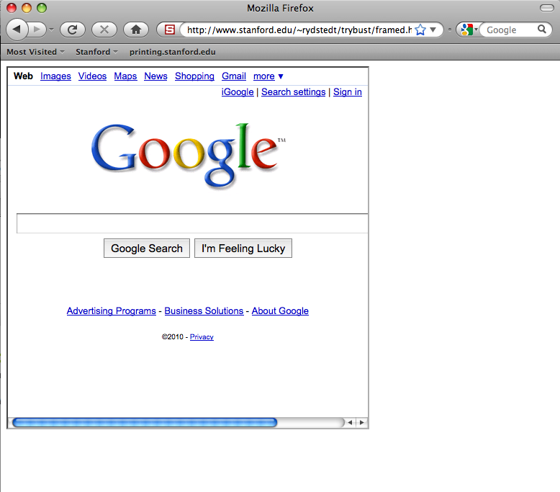
Framing: one site can frame another
<iframe name=“myframe” src=“http://www.google.com/”>
This text is ignored by most browsers.
</iframe>
framing page
framed page
Can this be abused?

Slide 10
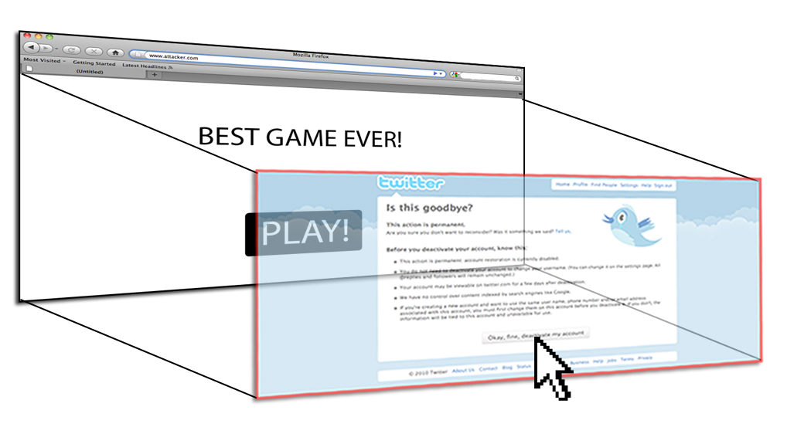
Clickjacking [rsnake’08]
User visits a gaming web site. Game frames Twitter site as:
(Twitter frame is occluded by game frame)

Slide 11
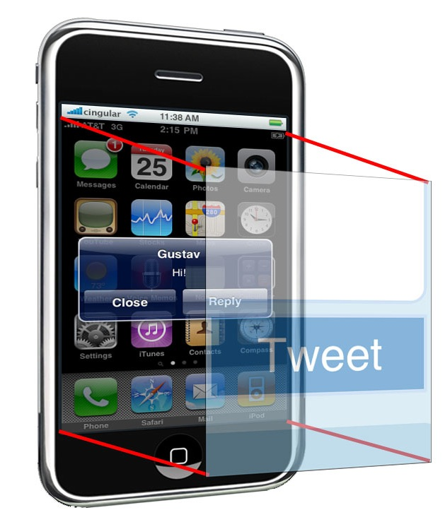
Tap-jacking attacks [RBB’10]
User visits a gaming web site:
Can zoom, and auto scroll
Web site displays an incoming text message screen, but frames Twitter

Slide 12
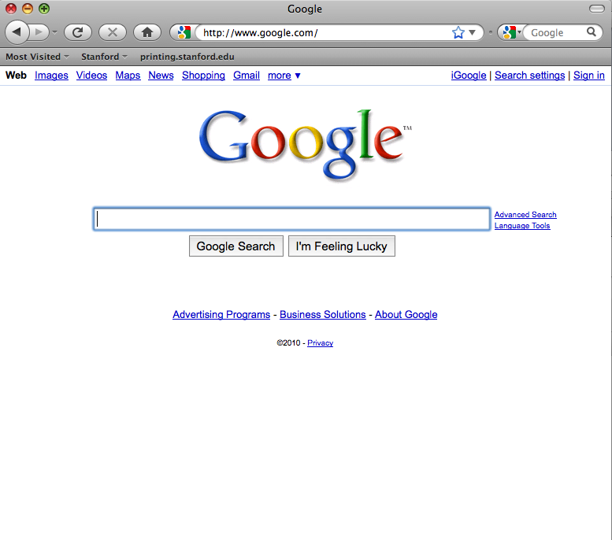
Incorrect solution: framebusting
Code on a page that prevents other pages from framing
if (top != self) { top.location = self.location; }

Slide 13
Many attacks
Example: on framing page:
      <script>
      window.addEventListener('beforeunload', function(e) {
      e.preventDefault();
      } )
      </script>
      <iframe src="http://www.paypal.com"> </iframe>
User likely to hit cancel and cancel framebusting

Slide 14
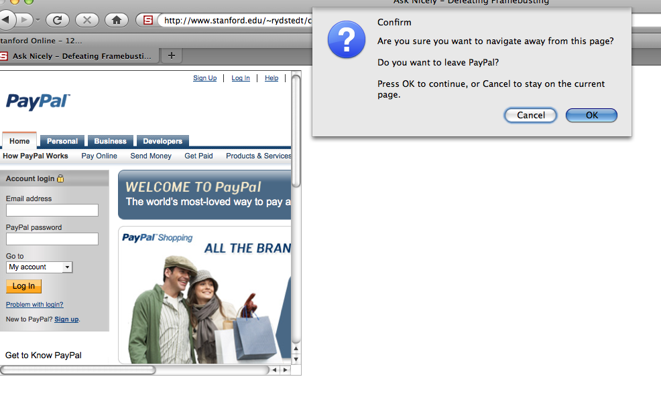
What the user will see

Slide 15
Correct defense: CSP
web browser
example.com
HTTP response from server:
HTTP/1.1 200 OK
…
Content-Security-Policy: frame-ancestors 'none’;
…
<iframe src=‘example.com’>
will cause an error
frame-ancestors ‘self’ ;
means only example.com
can frame page

Slide 16
Sub Resource Integrity (SRI)

Slide 17
The sub-resource integrity problem
top-level page
biz.com
sub-resource
code.jquery.com
in top-level page:
<script src=“https://code.jquery.com/jquery-3.5.1.min.js”
integrity="sha256-9/aliU8dGd2tb6OSsuzixeV4y/faTqgFtohetphbbj0=”
crossorigin="anonymous">
</script>
What if the sub-resource site serves bad content?

Slide 18
Sub-resource integrity (SRI)
SRI attribute can be added to scripts and style sheets:
<script src=“https://code.jquery.com/jquery-3.5.1.min.js”
integrity="sha256-9/aliU8dGd2tb6OSsuzixeV4y/faTqgFtohetphbbj0=”
crossorigin="anonymous">
</script>
<link rel='stylesheet’ type='text/css’ href='https://example.com/style.css’
integrity="sha256-9/aliU8dGd2tb6OSsuzixeV4y/faTqgFtohetphbbj0=”
crossorigin="anonymous">
integrity attribute: precomputed hash of the the target sub-resource
Notes:
Use SHA256 hash.
crossorigin="anonymous” means no credentials needed to access sub-resource

Slide 19
What the browser does
<script src=“https://code.jquery.com/jquery-3.5.1.min.js”
integrity="sha256-9/aliU8dGd2tb6OSsuzixeV4y/faTqgFtohetphbbj0=”
crossorigin="anonymous">
</script>
Browser: (1) load sub-resource, (2) compute hash of contents,
(3) compare value to the integrity attribute.
if hash mismatch: script or stylesheet are not executed
and an error is raised.
Note: SRI is not supported on IE
Notes:
crossorigin="anonymous” means no credentials needed to access sub-resource

Slide 20
Enforcing SRI using CSP
web browser
example.com
HTTP response from server:
HTTP/1.1 200 OK
…
Content-Security-Policy: require-sri-for script style;
…
Requires SRI for all scripts and style sheets on page

Slide 21
Interlude: Designing
Security Prompts

Slide 22
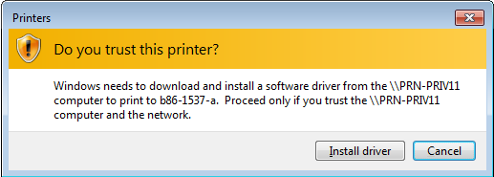
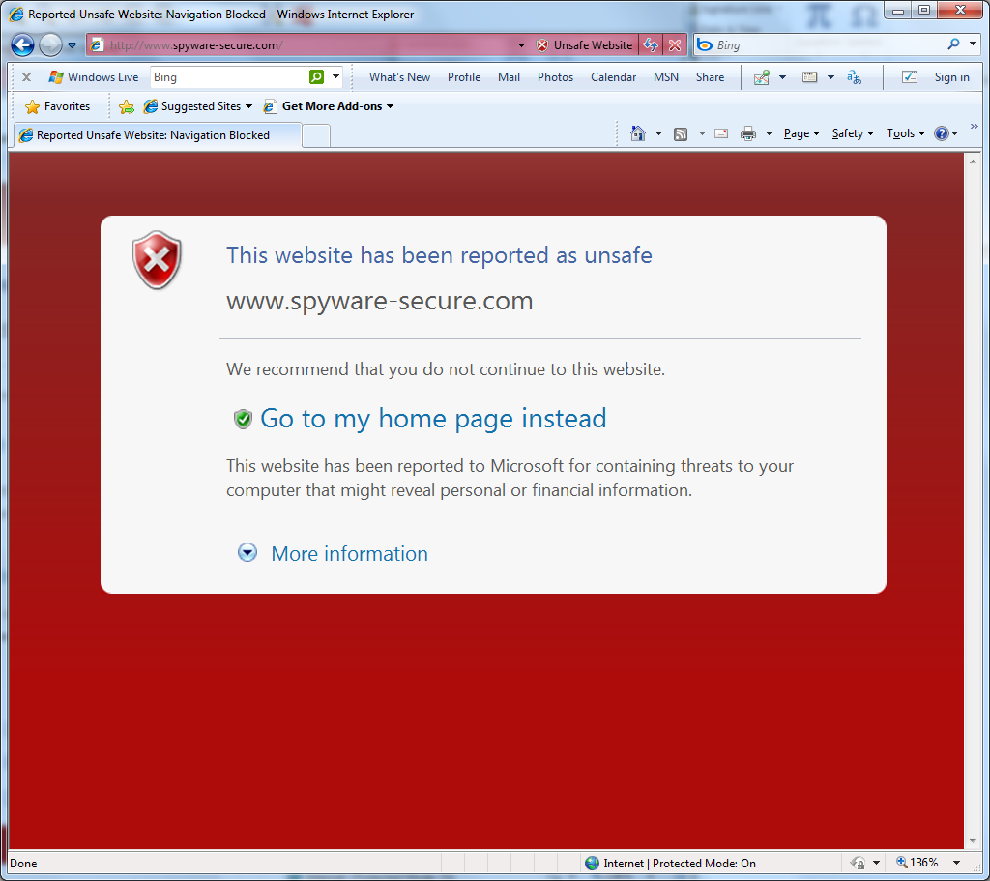
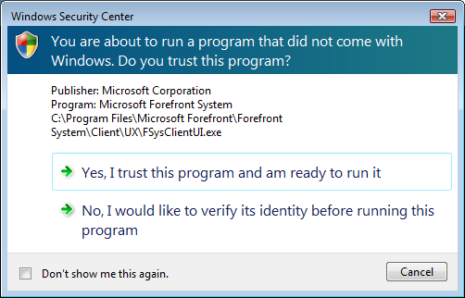
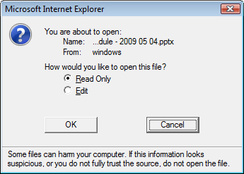
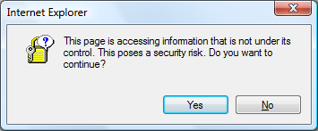
Users are faced with a lot of challenging trust-related decisions

Slide 23
An example problem: IE6 mixed context
Vague threat. What’s the risk? What could happen?
How should the user make this decision? No clear steps for user to follow.
“Yes”, the possibly less safe option, is the default
Notes:
This is the “mixed content” warning from IE6. It’s an example of a challenging decision that might have confronted an IE user.

Slide 24
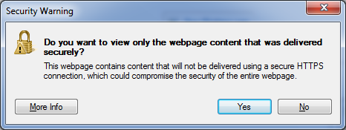
Better
(IE8)
Even better: load the safe content, and use the address bar to enable the rest
(IE9)
Notes:
Here’s the mixed content warning for IE8. Notice what’s changed… the logic has been reversed, so that now “Yes” does the safe thing by default, which is to load the secure content only.
Since it’s safe to load some of the content, the best experience from the user’s point of view might be to just load the safe stuff and provide a gold bar experience to get the rest. If the safe content is all they need, then they don’t even need to be bothered with a security decision. If they need to see more of the page, they can use the gold bar to load the rest of the page. This is exactly what was done in IE9, as this talk will show in a few slides.

Slide 25
Guidelines
Philosophy:
  Does the user have unique knowledge the system doesn’t?
  Don’t involve user if you don’t have to
  If you involve the user, enable them to make the right decision
Make sure your security dialogs are NEAT:
  Necessary: Can the system take action without the user?
  If the user has no unique knowledge, redesign system.
  Explained: see next slides
  Actionable: Can users make good decisions with your UI in both malicious and benign situations?
  Tested: Test your dialog on a few people who haven’t used the
  system before -- both malicious and benign situations.
Notes:
Examples of unique knowledge: is the user at an Internet Café or at a known safe location? User knows, but system does not.
Is the user doing their taxes or watching an Internet video?

Slide 26
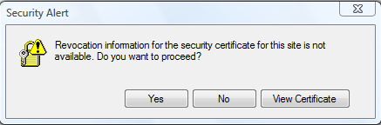

Example 1: bad explanation
IE6 CRL check failure notification
Most users will not understand “revocation information” .
Choices are unclear, consequence is unclear.

Slide 27
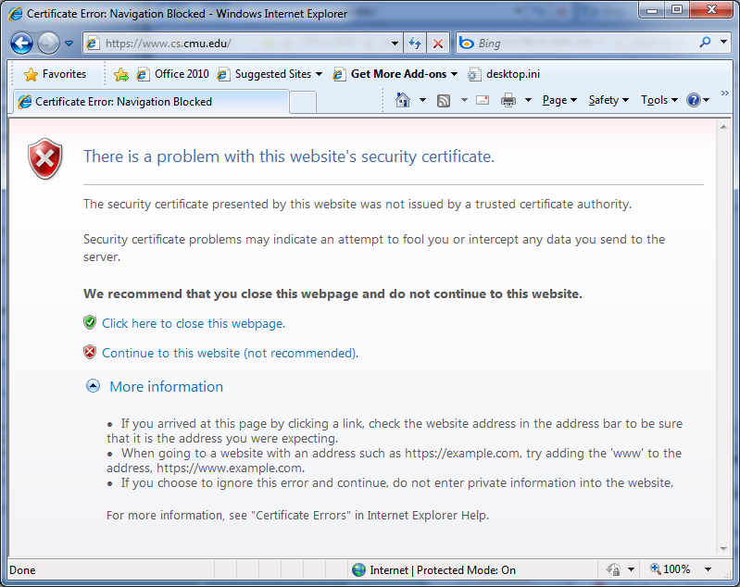
Better explanation
Source
Risk
Choices
Process
Notes:
Source is about showing the user where this decision is coming from and what they have to make a decision about. This dialog uses plain language to explain “there is a problem.” It notes the problem is with “this website.”
Process is about providing simple if/then steps any user could follow to usually make the right decision. Here the steps are, for example, to add “www” to the address if trying to use https; anyone can do that. The last bit of guidance says if you proceed, don’t share private info with the site; again, this is a simple bit of guidance any user can take to mitigate their risk. Statements like, “if you got this link from someone you don’t know, it’s probably an attempt to fool you, and we recommend you don’t proceed” can be very helpful to users.
Risk is about showing what bad thing might happen, and that’s plainly stated here with “an attempt to fool you or intercept any data” – concepts pretty much anyone can understand
Choices is about showing the available options, which here are to close the page or proceed, and showing which the software recommends, usually the safer option; here we make the recommendation clear with the use of green and red shields, as well as the text “(not recommended)” for the less safe option
Semantics, skipping ahead to the end of CHARGES, is about explaining what will happen when each option is chosen. Here I think the options are pretty clear, but be careful in cases like the mixed content warning I showed earlier where it wasn’t clear whether “No” would show everything or nothing
Unique Knowledge User Has and Evidence don’t really apply here, but see the next slides…

Slide 28
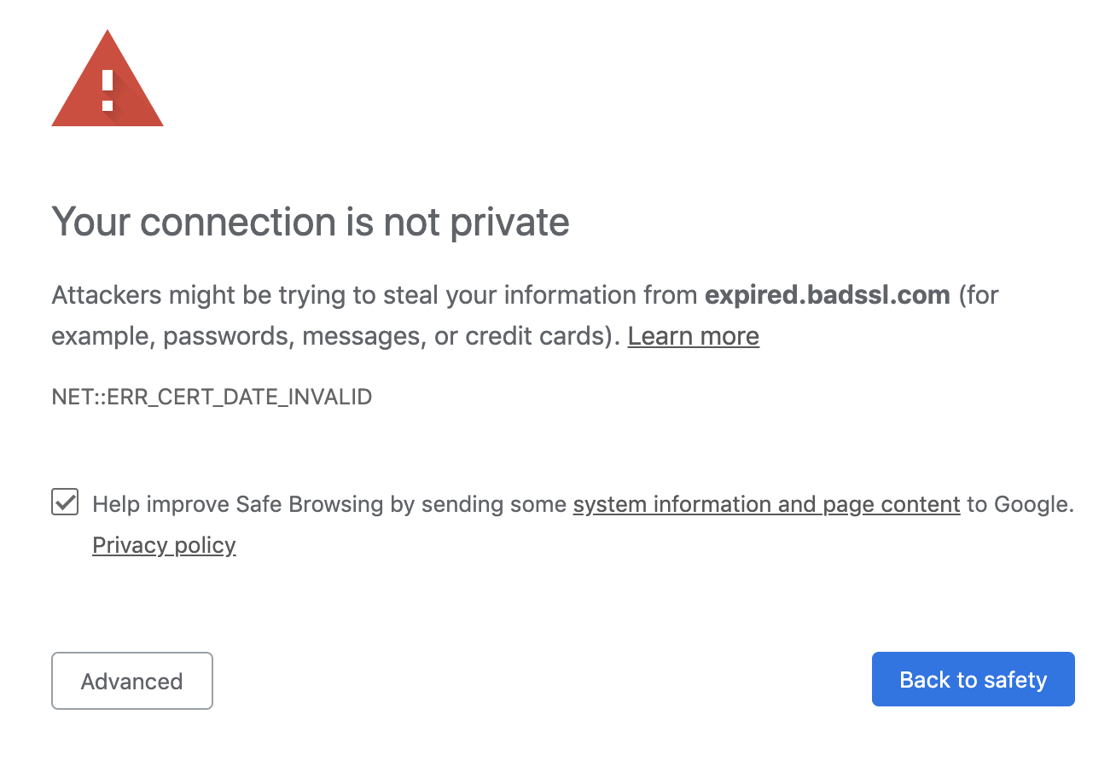
In Chrome (2019)
Risk
Explanation
Choices

Slide 29
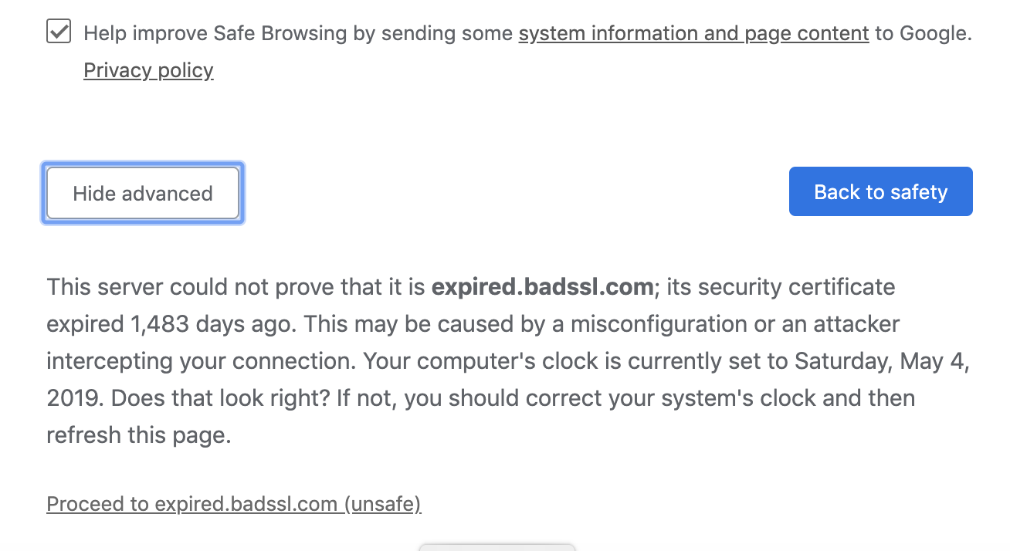
In Chrome (2019)
Process
Choice
(expired certificate)

Slide 30
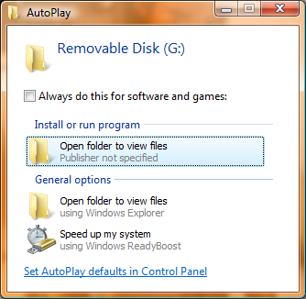
Example 2: bad explanation
AutoPlay dialog in Vista
Attacker can abuse explanation causing bad user decisions.
Used by Conficker spread through USB drives.
Notes:
Attacker created a file on USB called “Open folder to view files”

Slide 31
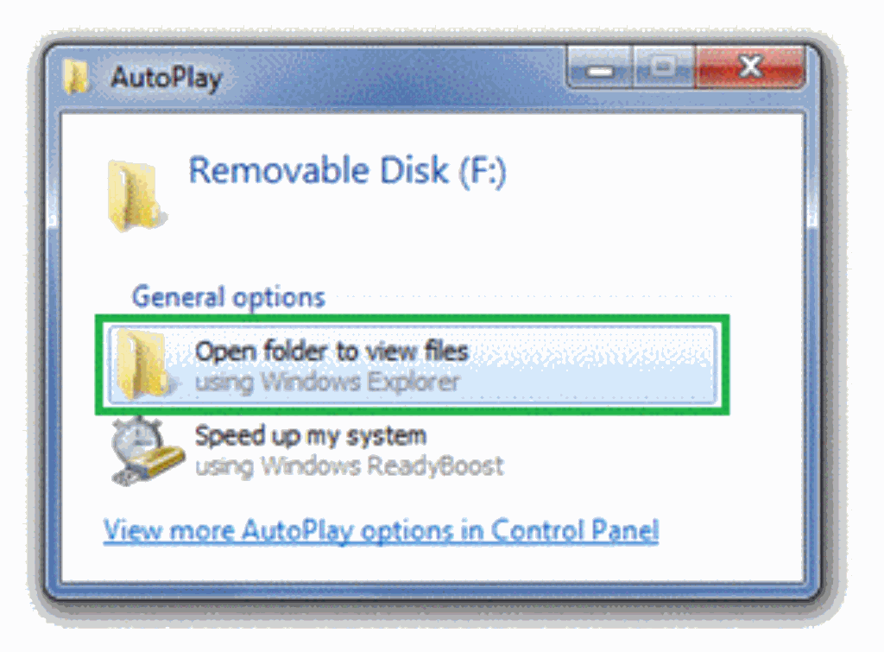
A better design
Windows 7 AutoPlay removed the auto-run option

Slide 32
Session Management and User Authentication on the Web
… back to Web security

Slide 33
Sessions
A sequence of requests and responses from one browser
to one (or more) sites
  Session can be long (e.g. Gmail) or short
  without session mgmt:
  users would have to constantly re-authenticate
Session mgmt: authorize user once;
  All subsequent requests are tied to user

Slide 34
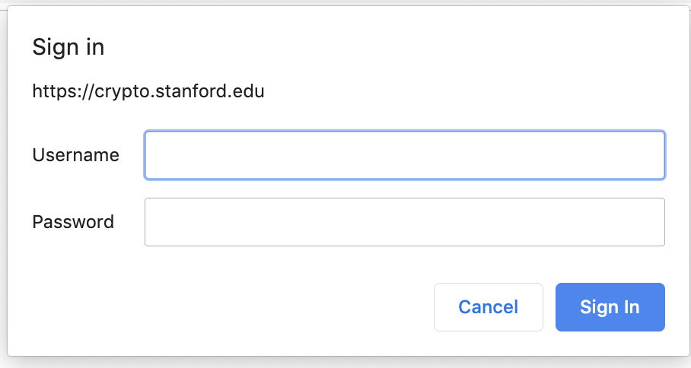
Pre-history: HTTP auth
HTTP request: GET /index.html
HTTP response contains:
WWW-Authenticate: Basic realm="Password Required“
Browsers sends hashed password on all subsequent HTTP requests:
Authorization: Basic ZGFddfibzsdfgkjheczI1NXRleHQ=

Slide 35
HTTP auth problems
Hardly used in commercial sites:
User cannot log out other than by closing browser
  What if user has multiple accounts?
  multiple users on same machine?
Site cannot customize password dialog
Confusing dialog to users
Easily spoofed
Do not use …

Slide 36
Session tokens
Browser
web site
GET /index.html
set anonymous session token
GET /books.html
anonymous session token
check
credentials
(crypto course)
POST /do-login
Username, password, and 2nd factor
elevate to a logged-in session token
POST /checkout
logged-in session token
Validate
token
Notes:
Validate token: check that it belongs to an active session that has not been logged out or timed out.

Slide 37
Storing session tokens:
Lots of options (but none are perfect)
Browser cookie:
Set-Cookie: SessionToken=fduhye63sfdb
Embed in all URL links:
https://site.com/checkout ? SessionToken=kh7y3b
In a hidden form field:
<input type=“hidden” name=“SessionToken” value=“uydh735”>

Slide 38
Storing session tokens: problems
Browser cookie: browser sends cookie with every request,
even when it should not (CSRF) [note: SameSite attribute]
Embed in all URL links: token leaks via HTTP Referer header
In a hidden form field: does not work for long-lived sessions
Best answer: a combination of all of the above
Supported in most frameworks
PHP ex: output_add_rewrite_var(name, value)
(or if user posts URL in a public blog)
Notes:
SameSite: used by default in PHPSESSION cookie since PHP 7.3 (2018)
output_add_rewrite_var(name, value): adds var to URL parameters and hidden form fields. By default, session token only in cookie (PHPSESSION).

Slide 39
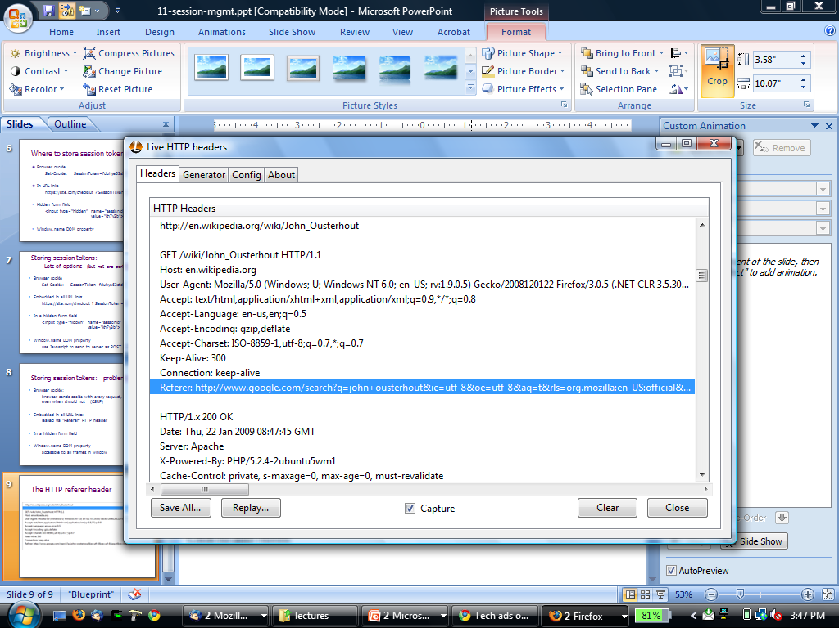
The HTTP referer header
Referer leaks URL session token to 3rd parties
Referer supression:
not sent when HTTPS site refers to an HTTP site
in HTML5: <a rel=”noreferrer” href=www.example.com>

Slide 40
The Logout Process
Web sites must provide a logout function:
Functionality: let user to login as different user
Security: prevent others from abusing account
What happens during logout:
  1. Delete SessionToken from client
  2. Mark session token as expired on server
Problem: many web sites do (1) but not (2) !!
⇒ Especially risky for sites who use HTTP after login

Slide 41
The Logout Process (cont.)
What if a user suspects their machine is compromised?
  Logging in from an untrusted machine (Internet Café), or
  Malware infection of user’s machine
Site must show all devices currently logged into user’s account
  Let user terminate any unrecognized device
  ⇒ mark terminated session token as expired on server

Slide 42
Session hijacking

Slide 43
Session hijacking
Attacker waits for user to login
then attacker steals user’s Session Token
and “hijacks” session
⇒ attacker can issue arbitrary requests on behalf of user
Example: FireSheep
Firefox extension: hijacks HTTP session tokens over WiFi
Solution: always send session tokens over HTTPS!

Slide 44
Beware: Predictable tokens
Example 1: counter
⇒ user logs in, gets counter value,
can view sessions of other users
Example 2: weak MAC. token = { userid, MAC_{k}(userid) }
Weak MAC exposes k from few cookies.
Apache Tomcat: generateSessionId()
Returns random session ID [server retrieves client state based on sess-id]
Notes:
Don’t generate your own. Use built in procedures: PHP, ASP, Tomcat, JServ

Slide 45
Session tokens must be unpredictable to attacker
To generate: use underlying framework (e.g. ASP, Tomcat, Rails)
Rails: token = SHA256( current time, random nonce )
Notes:
Don’t generate your own. Use built in procedures: ASP, Tomcat, JServ

Slide 46
Beware: Session token theft
Example 1: use of HTTP after login over HTTPS
Enables cookie theft at WiFi access point (e.g. Firesheep)
Other ways network attacker can steal token:
  Site has mixed HTTPS/HTTP pages ⇒ token sent over HTTP
  Man-in-the-middle attacks on SSL
Example 2: Cross Site Scripting (XSS) exploits
Amplified by poor logout procedures:
  Logout must invalidate token on server

Slide 47
Mitigating SessionToken theft by binding
SessionToken to client’s computer
A common idea: embed machine specific data in SID
Client IP addr: makes it harder to use token at another machine
  But honest client may change IP addr during session
    client will be logged out for no reason
Client user agent: weak defense against theft, but doesn’t hurt.
TLS session id: same problem as IP address (and even worse)
Notes:
Can also embed agent’s timezone.

Slide 48
Session fixation attacks
Suppose attacker can set the user’s session token:
For URL tokens, trick user into clicking on URL
For cookie tokens, set using XSS exploits
Attack: (say, using URL tokens)
Attacker gets anonymous session token for site.com
Sends URL to user with attacker’s session token
User clicks on URL and logs into site.com
  this elevates attacker’s token to logged-in token
Attacker uses elevated token to hijack user’s session.

Slide 49
Session fixation: lesson
When elevating user from anonymous to logged-in:
always issue a new session token
(e.g. in PHP by calling session_regenerate_id() in PHP)
After login, token changes to value unknown to attacker
⇒ Attacker’s token is not elevated.
Notes:
Problems with new SessionToken after every request: the back button (but can be dealt with with proper handling of replays)

Slide 50
Summary
Session tokens are split across multiple client state mechanisms:
  Cookies, hidden form fields, URL parameters
  Cookies by themselves are insecure (CSRF, cookie overwrite)
  Session tokens must be unpredictable and resist theft by network attacker
Ensure logout and timeout invalidates session on server

