Slide 1

HTTPS and the Lock Icon
Web security

Slide 2
Goals for this lecture
Brief overview of HTTPS:
  How the SSL/TLS protocol works (very briefly)
  How to use HTTPS
Integrating HTTPS into the browser
  Lots of user interface problems to watch for

Slide 3
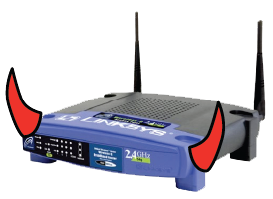
Threat Model: Network Attacker
Network Attacker:
Controls network infrastructure: Routers, DNS
Eavesdrops, injects, blocks, and modifies packets
Examples:
Wireless network at Internet Café
Internet access at hotels (untrusted ISP)

Slide 4
TLS overview: DH key exchange
(1) Anonymous key exchange secure against eavesdropping:
The Diffie-Hellman protocol in a group G = {1, g, g², g³, …, g^{q-1}}
Browser Alice
Server Bob
a ⟵ {1,…,q}
A = gª ∈ G
b ⟵ {1,…,q}
B = g^{b} ∈ G
Bª
A^{b}
DHkey = g^{ab} = (g^{b})ª = Bª = (gª)^{b} = A^{b}

Slide 5

(2) Certificates
How does Alice (browser) obtain PK_{Bob} ?
Browser
Alice
CA
Server Bob
choose
(SK,PK)
PK and
proof “I am Bob”
check
proof
PK_{CA}
PK_{CA}
SK_{CA}
issue Cert with SK_{CA} :
Verify
cert
Bob’s
key is PK
Bob’s
key is PK
Bob uses Cert for an extended period (e.g. one year)

Slide 6

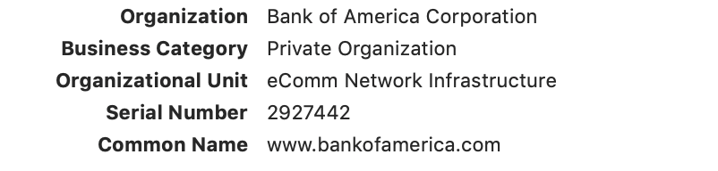
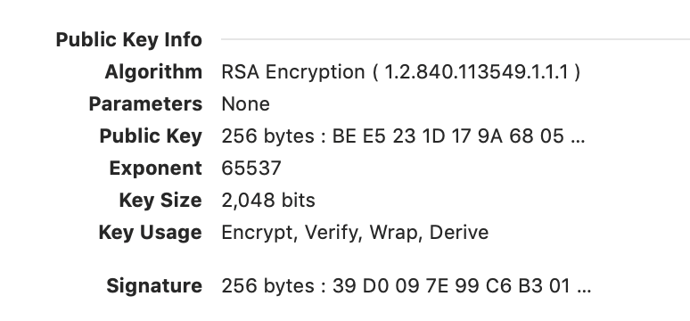
Sample certificate:
(by CA)

Slide 7
Certificates on the web
Subject’s CommonName can be:
An explicit name, e.g. cs.stanford.edu , or
A wildcard cert, e.g. *.stanford.edu or cs*.stanford.edu
matching rules:
“*” must occur in leftmost component, does not match “.”
example: *.a.com matches x.a.com but not y.x.a.com
(as in RFC 2818: “HTTPS over TLS”)

Slide 8
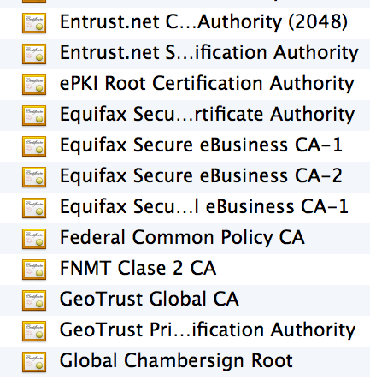
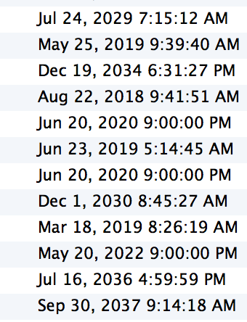
Certificate Authorities
⋮
Browsers accept
certificates from a
large number of CAs
Top level CAs ≈ 60
Intermediate CAs ≈ 1200
⋮

Slide 9
TLS 1.3 session setup (simplified)
Diffie-Hellman key exchange
Client
ClientHello: nonce_{C} , KeyShare
Server
ServerHello: nonce_{S} , KeyShare, Enc[cert_{S},…]
CertVerify: Enc[Sig_{S}(data)] , Finished
secret
key
cert_{S}
Finished
session-keys ← HKDF( DHkey, nonce_{C} , nonce_{S} )
Encrypted ApplicationData
Encrypted ApplicationData
Most common: server authentication only

Slide 10
TLS 1.3 session setup: optimization (and caution)
Client
ClientHello: nonce_{C}, KeyShare
, Enc[0-RTT data]
Server
ServerHello: nonce_{S} , KeyShare, Enc[cert_{S},…]
CertVerify: Enc[Sig_{S}(data)] , Finished
secret
key
Data encrypted using a pre-shared key
Caution: 0-RTT data is vulnerable to reply
⇒ data should have no side effects
(i.e. GET but not POST)
cert_{S}
Finished
session-keys ← HKDF( DHkey, nonce_{C} , nonce_{S} )
Encrypted ApplicationData
Encrypted ApplicationData
Most common: server authentication only

Slide 11
Integrating TLS with HTTP: HTTPS
web
proxy
Two complications
Web proxies
solution: browser sends
CONNECT domain-name
before client-hello
Virtual hosting:
two sites hosted at same IP address.
solution in TLS 1.1: SNI (June 2003)
client_hello_extension: server_name=cnn.com
implemented since FF2 and IE7 (vista)
web
server
corporate network
web
server
client-hello
server-cert ???
cert_{CNN}
cert_{ABC}
Notes:
SNI: server name indication

Slide 12
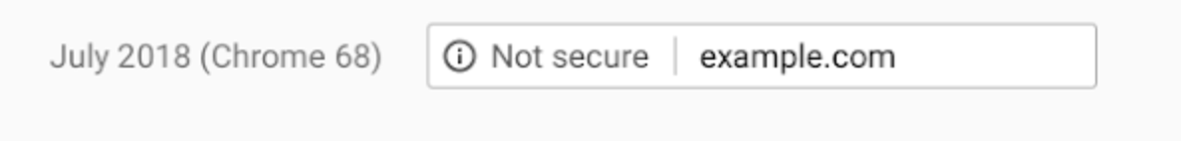
HTTPS for all web traffic?
Old excuses:
Crypto slows down web servers (not true anymore)
Some ad-networks still do not support HTTPS
  reduced revenue for publishers
Incompatible with virtual hosting (older browsers)
Since July 2018: Chrome marks HTTP sites as insecure

Slide 13
HTTPS in the Browser

Slide 14
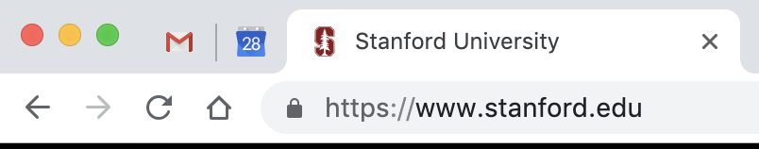
The lock icon: TLS indicator
Intended goal:
  Provide user with identity of page origin
  Indicate to user that page contents were not
  viewed or modified by a network attacker
Notes:
Network attacker: controls routers, DNS; can inject, delete, and modify packets

Slide 15
When is the (basic) lock icon displayed
All elements on the page fetched using HTTPS
For all elements:
    HTTPS cert issued by a CA trusted by browser
    HTTPS cert is valid (e.g. not expired)
    Domain in URL matches:
    CommonName or SubjectAlternativeName in cert

Slide 16
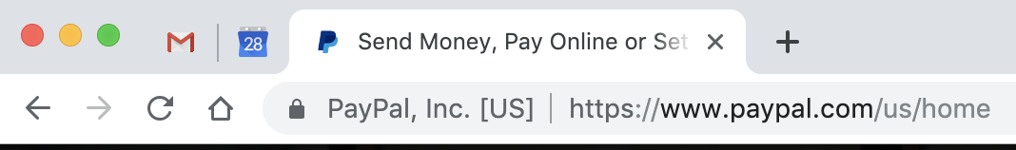
The lock UI: Extended Validation Certs
Harder to obtain than regular certs
      requires human at CA to approve cert request
      no wildcard certs (e.g. *.stanford.edu )
  Helps block “semantic attacks”: www.bankofthevvest.com
note: HTTPS-EV and HTTPS are in the same origin

Slide 17
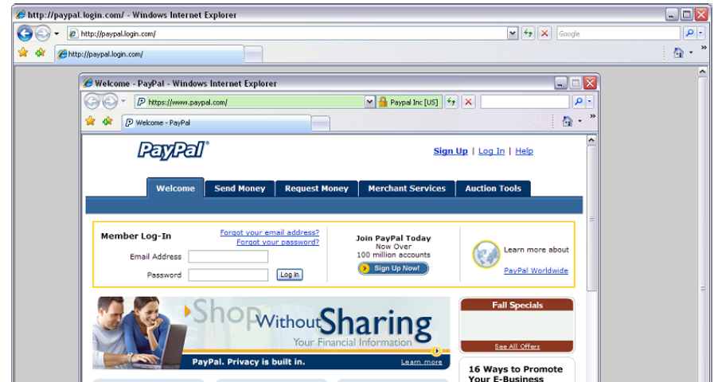
A general UI attack: picture-in-picture
Trained users are more likely to fall victim to this [JSTB’07]
Notes:
Both inner and outer windows are focused

Slide 18
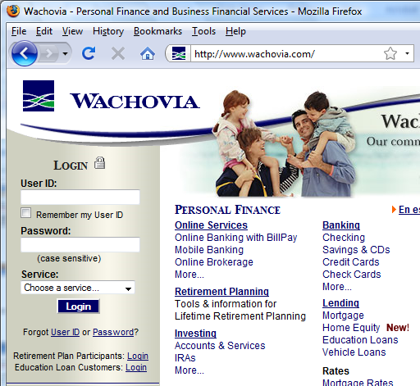
HTTPS and login pages: incorrect usage
Users often land on login page over HTTP:
    Type HTTP URL
    into address bar
Google links to HTTP page
View source:
<form method="post"
action="https://onlineservices.wachovia.com/..."
(old site)
Notes:
User has no way to tell that his password is sent over HTTPS to site.
Also has no way to tell that page wasn’t modified enroute (e.g. change form action).
Note the confusing lock next to “LOGIN” that suggests this is HTTPS.

Slide 19
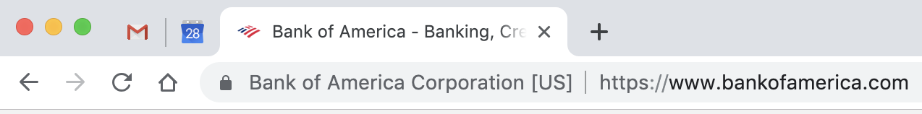
HTTPS and login pages: guidelines
General guideline:
    Response to http://login.site.com
    should be Location: https://login.site.com
(redirect)
Should be the response
to every HTTP request …

Slide 20
Problems with HTTPS and the Lock Icon

Slide 21
Problems with HTTPS and the Lock Icon
Upgrade from HTTP to HTTPS
Forged certs
Mixed content: HTTP and HTTPS on the same page
Does HTTPS hide web traffic?
  Problems: traffic analysis, compression attacks

Slide 22
1. HTTP ⇒ HTTPS upgrade
Common use pattern:
    browse site over HTTP; move to HTTPS for checkout
    connect to bank over HTTP; move to HTTPS for login
SSL_strip attack: prevent the upgrade [Moxie’08]
<a href=https://…> ⟶ <a href=http://…>
Location: https://... ⟶ Location: http://... (redirect)
<form action=https://… > ⟶ <form action=http://…>
HTTP
SSL
attacker
web
server
Notes:
ssl_strip: prevents browser from upgrading, but does the SSL upgrade when communicating with the server. Server has no idea this is taking place.
Similar attack done on SMTP STARTTLES : http://arstechnica.com/tech-policy/2014/11/condemnation-mounts-against-isp-that-sabotaged-users-e-mail-encryption/

Slide 23


Tricks and Details
Tricks: drop-in a clever fav icon (older browsers)
⇒ fav icon no longer presented in address bar
Number of users who detected HTTP downgrade: 0
⟶

Slide 24
Defense: Strict Transport Security (HSTS)
Strict-Transport-Security: max-age=63072000; includeSubDomains
(ignored if not over HTTPS)
web
server
Header tells browser to always connect over HTTPS
Subsequent visits must be over HTTPS (self signed certs result in an error)
Browser refuses to connect over HTTP or if site presents an invalid cert
Requires that entire site be served over valid HTTPS
HSTS flag deleted when user “clears private data” : security vs. privacy
Notes:
max-age is given in seconds: 63072000 is two years (most common value among top 1M sites). HSTS header only accepted over HTTPS.
HSTS preloaded list: list of HSTS sites embedded in browser … in source code.
Apr. 2017: 5,500 sites use of Alexa Top 100K sites. (http://trends.builtwith.com/docinfo/HSTS)
To examine HSTS database use: chrome://net-internals/#hsts

Slide 25

Preloaded HSTS list
https://hstspreload.org/
Strict-Transport-Security: max-age=63072000; includeSubDomains; preload
Preload list hard-coded in Chrome source code. Examples:
Google, Paypal, Twitter, Simple, Linode, Stripe, Lastpass, …
Notes:
63072000: two years
Preload attribute tells Chrome team to add site to the preload list.
Preoad is in the Chrome source code … takes a while until widely deployed.

Slide 26
CSP: upgrade-insecure-requests
The problem: many pages use <img src=“http://site.com/img”>
Makes it difficult to migrate a section of a site to HTTPS
Solution: gradual transition using CSP
Content-Security-Policy: upgrade-insecure-requests
<img src=“http://site.com/img”>
<img src=“http://othersite.com/img”>
<a href=“http://site.com/img”>
<a href=“http://othersite.com/img”>
<img src=“https://site.com/img”>
<img src=“https://othersite.com/img”>
<a href=“https://site.com/img”>
<a href=“http://othersite.com/img”>
Notes:
Resources and internal links are upgraded to HTTPS. External links are not.
Unlike HSTS, can be applied to sections of a site. Does not require changing page contents.

Slide 27
2. Certificates: wrong issuance
2011: Comodo and DigiNotar CAs hacked, issue certs for Gmail, Yahoo! Mail, …
2013: TurkTrust issued cert. for gmail.com (discovered by pinning)
2014: Indian NIC (intermediate CA trusted by the root CA IndiaCCA) issue certs
for Google and Yahoo! domains
Result: (1) India CCA revoked NIC’s intermediate certificate
(2) Chrome restricts India CCA root to only seven Indian domains
2016: WoSign (Chinese CA) issues cert for GitHub domain (among other issues)
Result: WoSign certs no longer trusted by Chrome and Firefox
⇒ enables eavesdropping w/o a warning on user’s session
Notes:
India CCA event: http://googleonlinesecurity.blogspot.com/2014/07/maintaining-digital-certificate-security.html
CNNIC event: http://googleonlinesecurity.blogspot.com/2015/03/maintaining-digital-certificate-security.html

Slide 28
Man in the middle attack using rogue cert
GET https://bank.com
BadguyCert
BankCert
ClientHello
attacker
ClientHello
bank
ServerCert (rogue)
ServerCert (Bank)
(cert for Bank by a valid CA)
SSL key exchange
SSL key exchange
k₁
k₁
k₂
k₂
HTTP data enc with k₁
HTTP data enc with k₂
Attacker proxies data between user and bank.
Sees all traffic and can modify data at will.

Slide 29
What to do? (many good ideas)
Public-key pinning (static pins)
  Hardcode list of allowed CAs for certain sites (Gmail, facebook, …)
  Browser rejects certs issued by a CA not on list
  Now deprecated (because often incorrectly used in practice)
Certificate Transparency (CT): [LL’12]
  idea: CA’s must advertise a log of all certs. they issued
  Browser will only use a cert if it is published on (two) log servers
    Server attaches a signed statement from log (SCT) to certificate
  Companies can scan logs to look for invalid issuance
Notes:
SCT: signed certificate timestamp
Google stores all certs it sees (stored in google DNS)

Slide 30
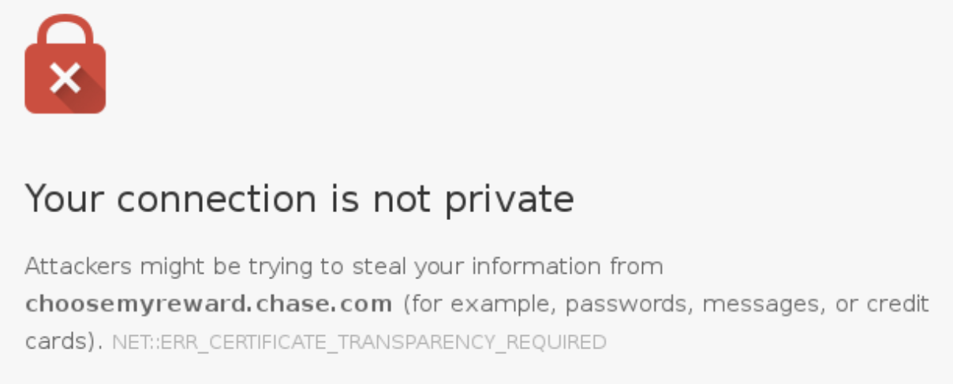
CT requirements
April 30, 2018: CT required by chrome
Required for all certificates with a path to a trusted root CA
(not required for an installed root CA)
Otherwise: HTTPS errors
Cert for crypto.stanford.edu
published on five logs:
  cloudflare_nimbus2018
  google_argon2018, google_aviator
  google_pilot, google_rocketeer
Notes:
https://transparencyreport.google.com/https/certificates

Slide 31
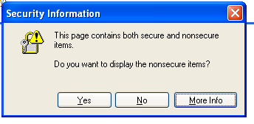
3. Mixed Content: HTTP and HTTPS
Page loads over HTTPS, but contains content over HTTP
(e.g. <script src=“http://.../script.js> )
  ⇒ Active network attacker can hijack session
by modifying script en-route to browser
never write this
IE7:
Old Chrome:
Mostly ignored by users …

Slide 32


https://badssl.com (Chrome 73, 2019)
Mixed script: <script src="http://mixed-script.badssl.com/nonsecure.js"></script>
Mixed form: <form action="http://http.badssl.com/resources/submit.html">
(script is blocked, click to load)
Form loaded, but no HTTPS indicator

Slide 33
4. Peeking through SSL: traffic analysis
Network traffic reveals length of HTTPS packets
  TLS supports up to 256 bytes of padding
AJAX-rich pages have lots and lots of interactions with the server
These interactions expose specific internal state of the page
BAM!
Chen, Wang, Wang, Zhang, 2010

Slide 34
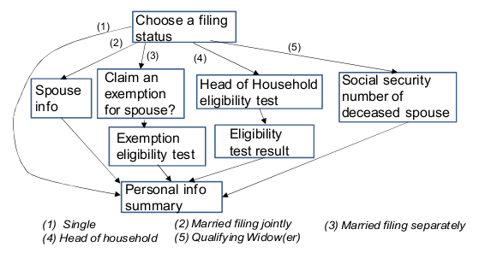
Peeking through SSL: an example [CWWZ’10]
Vulnerabilities in an online tax application
No easy fix. Can also be used to ID Tor traffic

Slide 35
THE END

