Slide 1

Symmetric encryption, Public key encryption, and TLS
Crypto Concepts

Slide 2
Cryptography
Is:
  A tremendous tool
  The basis for many security mechanisms
Is not:
  The solution to all security problems
  Reliable unless implemented and used properly
  Something you should try to invent yourself

Slide 3
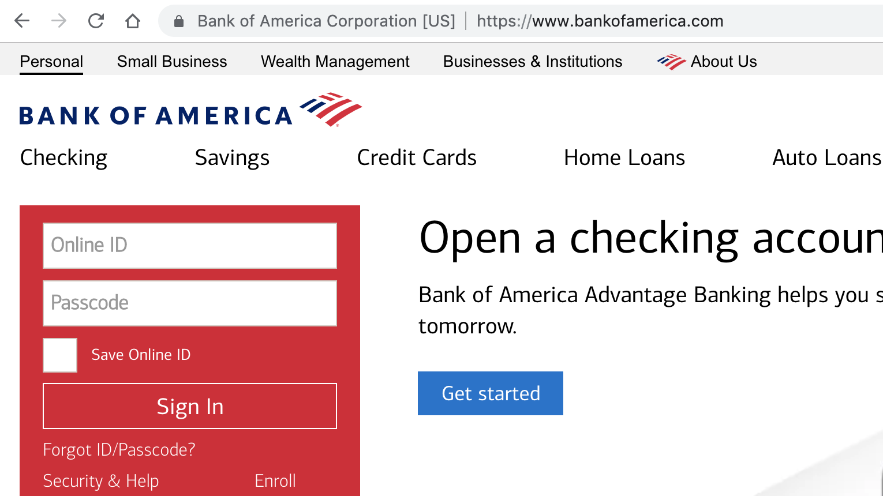
Goal 1: Secure communication
(protecting data in motion)
no eavesdropping
no tampering

Slide 4
Transport Layer Security / TLS
Standard for Internet security
  Goal: “... provide privacy and reliability between two communicating applications”
Two main parts
  1. Handshake Protocol: Establish shared secret key
  using public-key cryptography
  2. Record Layer: Transmit data using negotiated key
  Our starting point: Using a key for encryption and integrity

Slide 5
Goal 2: protected files
(protecting data at rest)
File system
File 1
Alice
Alice
No eavesdropping
No tampering
File 2

Slide 6
Building block: symmetric cipher
nonce
E, D: cipher k: secret key (e.g. 128 bits)
m, c: plaintext, ciphertext n: nonce (non-repeating)
Encryption algorithm is publicly known
  ⇒ never use a proprietary cipher
Alice
Bob
m, n
E
E(k,m,n)=c
c, n
D
D(k,c,n)=m
k
k

Slide 7
Use Cases
Single use key: (one time key)
  Key is only used to encrypt one message
    encrypted email: new key generated for every email
  No need for nonce (set to 0)
Multi use key: (many time key)
  Key used to encrypt multiple messages
    TLS: same key used to encrypt many packets
  Use either a unique nonce or a random nonce

Slide 8
First example: One Time Pad (single use key)
Vernam (1917)
Key:
0
1
0
1
1
1
0
0
1
0
⊕
Plaintext:
1
1
0
0
0
1
1
0
0
0
Ciphertext:
1
0
0
1
1
0
1
0
1
0
Encryption: c = E(k, m) = m ⨁ k
Decryption: D(k, c) = c ⨁ k
= (m ⨁ k) ⨁k = m
Notes:
Fill in CT manually.

Slide 9
One Time Pad (OTP) Security
Shannon (1949):
  OTP is “secure” against one-time eavesdropping
  without key, ciphertext reveals no “information”
  about plaintext
Problem: OTP key is as long as the message

Slide 10
Stream ciphers (single use key)
Problem: OTP key is as long as the message
Solution: Pseudo random key -- stream ciphers
Example: ChaCha20 (one-time if no nonce) key: 128 or 256 bits.
key
c ← PRG(k) ⊕ m
PRG
⊕
message
ciphertext
Notes:
Pentium 4, 2.1GhZ

Slide 11
Dangers in using stream ciphers
One time key !! “Two time pad” is insecure:
c₁ ← m₁ ⊕ PRG(k)
  c₂ ← m₂ ⊕ PRG(k)
  Eavesdropper does:
  c₁ ⊕ c₂ → m₁ ⊕ m₂
  Enough redundant information in English that:
  m₁ ⊕ m₂ → m₁ , m₂
What if want to use
same key to encrypt
two files?

Slide 12
Block ciphers: crypto work horse
n bits
n bits
E, D
PT Block
CT Block
Key
k Bits
Canonical examples:
3DES: n= 64 bits, k = 168 bits
AES: n=128 bits, k = 128, 192, 256 bits

Slide 13
Block Ciphers Built by Iteration
key k
key expansion
k₁
k₂
k₃
k_{n}
m
R(k₁, ⋅)
R(k₂, ⋅)
R(k₃, ⋅)
R(k_{n}, ⋅)
c
R(k,m): round function
for 3DES (n=48), for AES-128 (n=10)

Slide 14
Example: AES128
input: 128-bit block m, 128-bit key k. output: 128-bit block c.
Difficult to design: must resist subtle attacks
• differential attacks, linear attacks, brute-force, …
key k
key expansion
k₀
k₁
k₂
k₁₀
m
⊕
π
⊕
π
⊕
π
⊕
c
’

Slide 15
Incorrect use of block ciphers
Electronic Code Book (ECB):
Problem:
  if m₁=m₂ then c₁=c₂
PT:
m₁
m₂
CT:
c₁
c₂

Slide 16
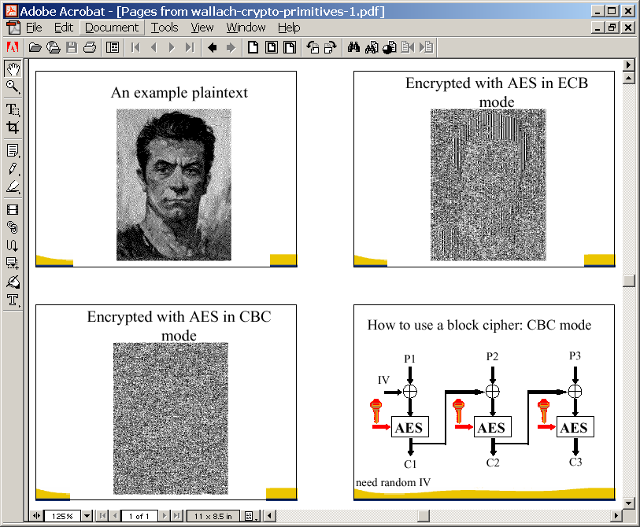
In pictures

Slide 17
CTR mode encryption (eavesdropping security)
Counter mode with a random IV: (parallel encryption)
IV
m[0]
m[1]
…
m[L]
⊕
E(k,IV)
E(k,IV+1)
…
E(k,IV+L)
IV
c[0]
c[1]
…
c[L]
ciphertext
Why is this secure for multiple messages? See the crypto course (cs255)

Slide 18
Performance
OpenSSL on Intel Haswell, 2.3 GHz ( Linux)
Cipher Block/key size Speed (MB/sec)
ChaCha 408
3DES 64/168 30
AES128 128/128 176
AES256 128/256 135
stream
block
(w/o AES-NI)

Slide 19
A Warning
eavesdropping security is insufficient for most applications
Need also to defend against active (tampering) attacks.
CTR mode is insecure against active attacks!
Next: methods to ensure message integrity

Slide 20
Message Integrity: MACs
Goal: provide message integrity. No confidentiality.
  ex: Protecting public binaries on disk.
k
k
message m
tag
Alice
Bob
Generate tag:
tag ← S(k, m)
Verify tag:
V(k, m, tag) = `yes’
?

Slide 21
Construction: HMAC (Hash-MAC)
Most widely used MAC on the Internet.
H: hash function.
example: SHA-256 ; output is 256 bits
Building a MAC out of a hash function:
  Standardized method: HMAC
  S( k, msg ) = H( k⊕opad ‖ H( k⊕ipad ‖ msg ) )

Slide 22
SHA-256: Merkle-Damgard
m[0]
m[1]
m[2]
m[3]
IV
(fixed)
h
h
h
h
H(m)
h(t, m[i]): compression function
Thm 1: if h is collision resistant then so is H
“Thm 2”: if h is a “PRF” then HMAC is a secure MAC

Slide 23
Why is this MAC construction secure?
… see the crypto course (cs255)

Slide 24
Combining MAC and ENC (Auth. Enc.)
Encryption key k_{E}. MAC key = k_{I}
Option 1: (SSL)
Option 2: (IPsec)
Option 3: (SSH)
MAC(k_{I}, m)
enc k_{E}
msg m
msg m
MAC
Enc k_{E}
MAC(k_{I}, c)
always
correct
msg m
MAC
enc k_{E}
MAC(k_{I}, m)
msg m
MAC

Slide 25
AEAD: Auth. Enc. with Assoc. Data
AEAD:
encrypted
associated data
encrypted data
authenticated
AES-GCM: CTR mode encryption then MAC
(MAC accelerated via Intel’s PCLMULQDQ instruction)

Slide 26
Example AES-GCM encryption function
int encrypt(
unsigned char *key, // key
unsigned char *iv, int iv_len, // nonce
unsigned char *plaintext, int plaintext_len, // plaintext
unsigned char *aad, int aad_len, // assoc. data
unsigned char *ciphertext // output ct
)

Slide 27
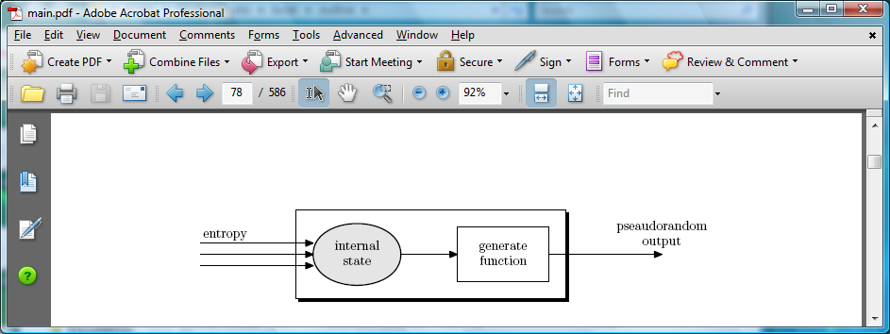
Generating Randomness (e.g. keys, nonces)
Pseudo random generators in practice: (e.g. /dev/random)
  Continuously add entropy to internal state
  Entropy sources:
    Hardware RNG: Intel RdRand inst. (Ivy Bridge). 3Gb/sec.
  Timing: hardware interrupts (keyboard, mouse)

Slide 28
Summary
Shared secret key:
Used for secure communication and document encryption
Encryption: (eavesdropping security) [should not be used standalone]
One-time key: stream ciphers, CTR with fixed IV
Many-time key: CTR with random IV
Integrity: HMAC or CW-MAC
Authenticated encryption: encrypt-then-MAC using GCM

Slide 29
Public key cryptography
Crypto Concepts

Slide 30
Public-key encryption
Tool for managing or generating symmetric keys
E – Encryption alg. PK – Public encryption key
D – Decryption alg. SK – Private decryption key
Algorithms E, D are publicly known.
Alice₁
m₁
Bob
E
E(PK, m₁)=c₁
c
D
D(SK,c)=m
Alice₂
m₂
E
E(PK, m₂)=c₂

Slide 31
Building block: trapdoor permutations
1. Algorithm KeyGen: outputs pk and sk
2. Algorithm F(pk, ⋅) : a one-way function
  Computing y = F(pk, x) is easy
  One-way: given random y finding x s.t. y = F(pk,x) is difficult
3. Algorithm F⁻¹(sk, ⋅) : Invert F(pk, ⋅) using trapdoor SK
  F⁻¹(sk, y ) = x

Slide 32
Example: RSA
1. KeyGen: generate two equal length primes p, q
set N ← p⋅q (3072 bits ≈ 925 digits)
set e ← 2¹⁶+1 = 65537 ; d ← e⁻¹ (mod ϕ(N))
pk = (N, e) ; sk = (N, d)
2. RSA(pk, x) : x → (x^{e} mod N)
  Inverting this function is believed to be as hard as factoring N
3. RSA⁻¹(pk, y) : y → (y^{d} mod N)

Slide 33
Public Key Encryption with a TDF
c₀
c₁
KeyGen: generate pk and sk
Encrypt(pk, m):
  choose random x ∈ domain(F) and set k ← H(x)
  c₀ ← F(pk, x) , c₁ ← E(k, m) (E: symmetric cipher)
  send c = (c₀, c₁)
Decrypt(sk, c=(c₀,c₁) ): x ← F⁻¹(sk, c₀) , k ← H(x) , m ← D(k, c₁)
security analysis in crypto course

Slide 34
Digital signatures
Goal: bind document to author
  Problem: attacker can copy Alice’s sig from one doc to another
Main idea: make signature depend on document
Example: signatures from trapdoor functions (e.g. RSA)
    sign( sk, m) := F⁻¹ (sk, H(m) )
    verify(pk, m, sig) := accept if F(pk, sig) = H(m)

Slide 35
Digital Sigs. from a Trapdoor Permutation
sign(sk, msg):
verify(pk, msg, sig):
msg
msg
H
H
≟ ⇒
accept
or
reject
F⁻¹(sk,⋅)
sig
F(pk,⋅)
sig

Slide 36

  Certificates: bind Bob’s ID to his PK
How does Alice (browser) obtain Bob’s public key pk_{Bob} ?
Browser
Alice
Server Bob
CA
generate
(sk,pk)
pk and
proof “I am Bob”
check
proof
sk_{CA}
pk_{CA}
pk_{CA}
issue Cert with sk_{CA} :
Bob’s
key is pk
verify
cert
Bob’s
key is pk
Bob uses Cert for an extended period (e.g. one year)

Slide 37
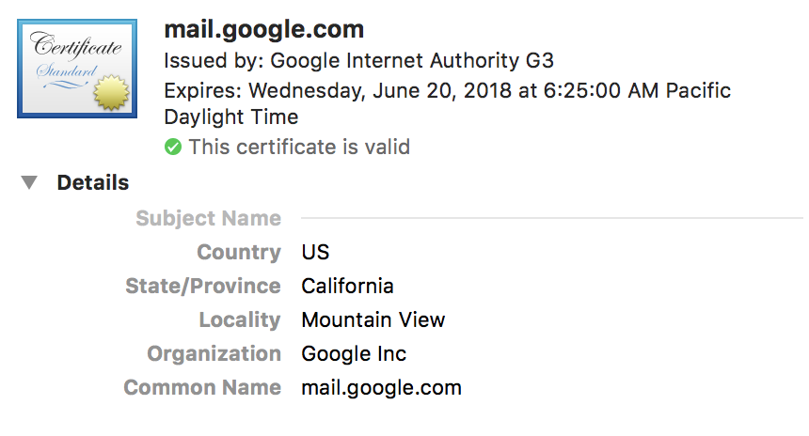
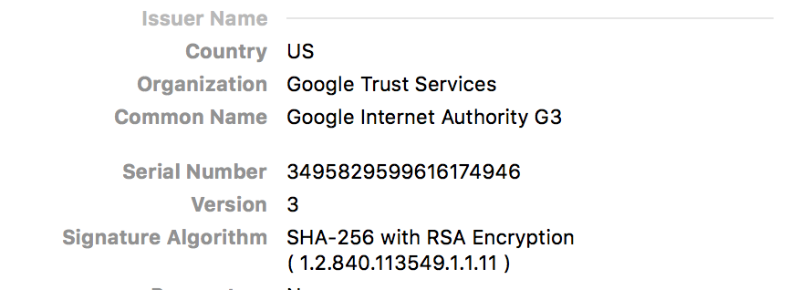
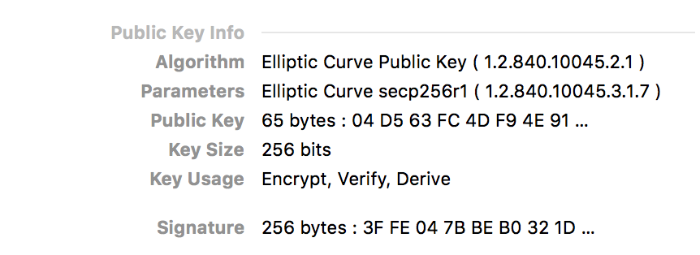
Sample certificate:

Slide 38
Back to TLS 1.3 session setup (simplified)
Client
ClientHello
Server
C
S
ServerHello,
[Certificate],
[CertificateVerify],
[Finished]
secret
key
[Certificate],
[CertificateVerify]
Finished
AppilcationData
cert_{S}
ApplicationData

Slide 39
TLS 1.3 session setup (simplified)
Diffie-Hellman key exchange
Client
ClientHello: nonce_{C} , KeyShare
Server
ServerHello: nonce_{S} , KeyShare, Enc[cert_{S},…]
CertVerify: Enc[Sig_{S}(data)] , Finished
secret
key
cert_{S}
Finished
session-keys ← HKDF( DHkey, nonce_{C} , nonce_{S} )
Encrypted ApplicationData
Encrypted ApplicationData

Slide 40
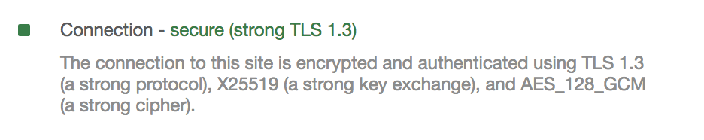
Properties
Gmail
Nonces: prevent replay of an old session
Forward secrecy: server compromise does not expose old sessions
Some identity protection: certificates are sent encrypted
One sided authentication:
  Browser identifies server using server-cert
  TLS has support for mutual authentication
    Rarely used: requires a client pk/sk and client-cert

Slide 41
A brief sample of advanced crypto
Crypto Concepts

Slide 42

Protocols
v₁
v₂
v₃
v₄
Elections
Can we do the same without
a trusted party?
trusted
authority
MAJ(v₁, v₂, v₃, v₄)

Slide 43
Protocols
v₁
v₂
v₃
v₄
Elections
Private auctions
Secure multi-party computation
f(v₁, v₂, v₃, v₄)
Goal: compute f(v₁, v₂, v₃, v₄)
“Thm:” anything that can be done with a trusted authority
can also be done without

Slide 44


Magical applications
Privately outsourcing computation
Zero knowledge (proof of knowledge)
What did she search for?
search
query
E[ query ]
Alice
E[ results ]
results
Google
???
N=p∙q
Alice
I know the factors of N !!
proof π
N
Bob
Notes:
ZKPK: can be used for authentication

Slide 45
Privacy: Group Signatures
msg
User 1
sig
Key Issuer
Is sig from user 1 or 2?
User 2
Simple solution: give all users same private key
… but also need to revoke signers when they misbehave

Slide 46
Example: Vehicle Safety Comm. (VSC)
1.
Car 1
Car 2
Car 3
Car 4
brake
out of my way !!
2.
Car
Ambulance
Require authenticated (signed) messages from cars.
  Prevent impersonation and DoS on traffic system.
Privacy problem: cars broadcasting signed (x,y, v).
Clean solution: group sigs. Group = set of all cars.

Slide 47
Summary: crypto concepts
Symmetric cryptography:
Authenticated Encryption (AE) and message integrity
Public-key cryptography:
Public-key encryption, digital signatures, key exchange
Certificates: bind a public key to an identity using a CA
  Used in TLS to identify server (and possibly client)
Modern crypto: goes far beyond basic encryption and signatures

